Slide 1
Traction and the NSEAD Survey Report 2015-16
Art, craft and design education: Celebrating and
amplifying our subject - Lesley Butterworth, General Secretary, NSEAD
www.nsead.org

Slide 2
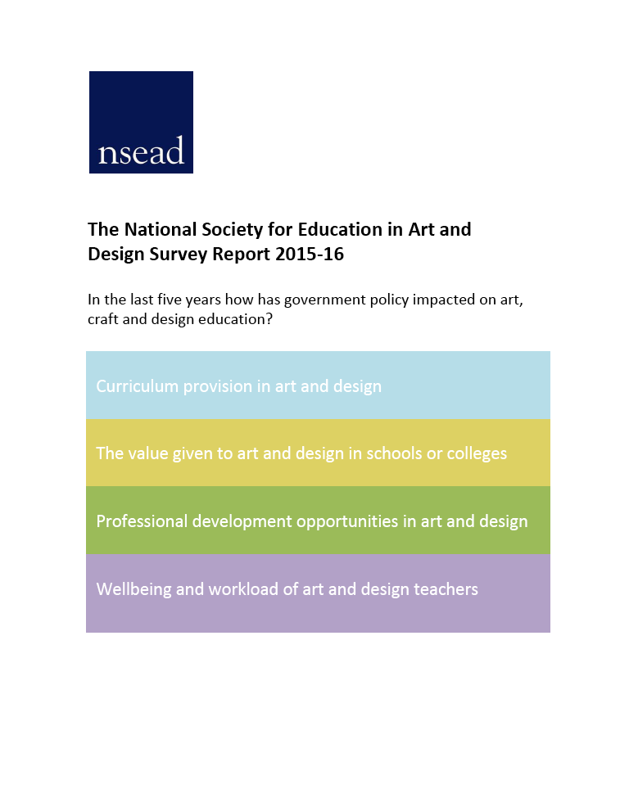
The NSEAD Survey Report 2015-16
nsead.org/downloads/survey.pdf
#nseadsurvey

Slide 3
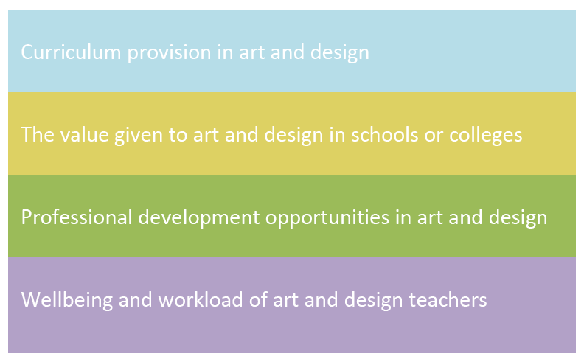
The NSEAD Survey Report 2015-16
nsead.org/downloads/survey.pdf #nseadsurvey
Why?
In the last five years how has government policy impacted on art, craft and design education?

Slide 4
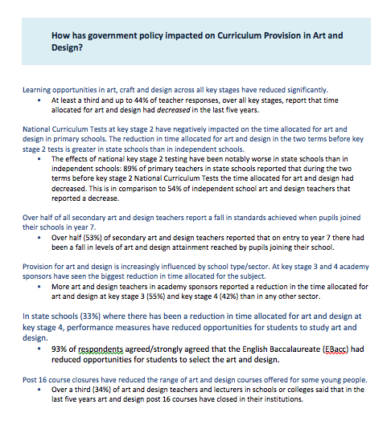
Q: How has government policy impacted on curriculum provision in art and design?
KEY FINDING: Learning opportunities in art, craft and design across all key stages have reduced significantly.

Slide 5
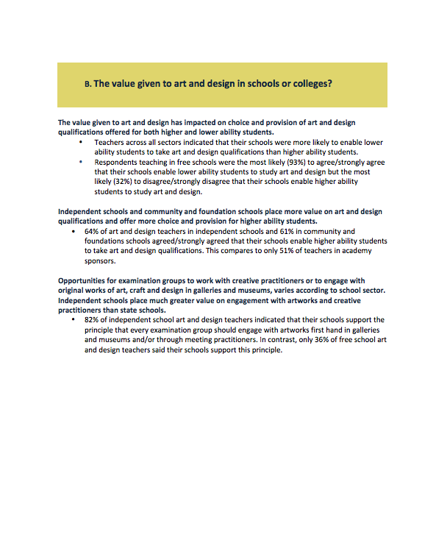
Q: How has government policy impacted on the value given to art and design in schools or colleges?
KEY FINDINGS: The value given to art and design has impacted on choice and provision of art and design qualifications offered for both higher and lower ability students.

Slide 6
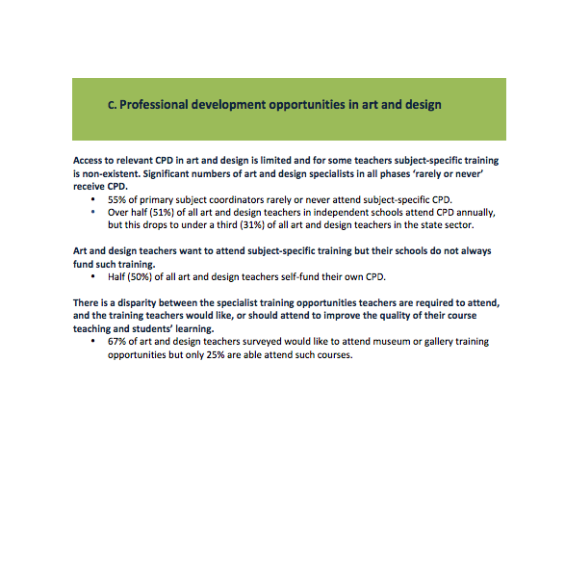
Q: How has government policy impacted on continuing professional development opportunities in art and design?
KEY FINDING: Access to relevant CPD (continuing professional development) in art and design is limited and for some teachers subject-specific training is non- existent.
AND
Significant numbers of art and design specialists in all phases ‘rarely or never’ receive CPD.

Slide 7
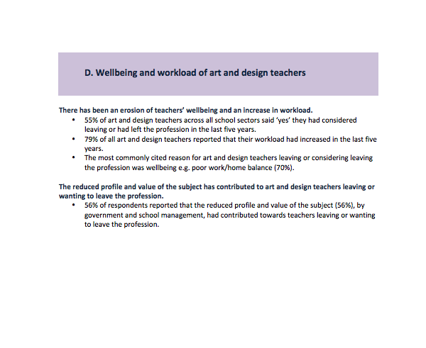
Q: How has government policy impacted on
wellbeing and workload of art and design teachers?
KEY FINDINGS:
There has been an erosion of wellbeing and an increase in workload.
AND
The reduced profile and value of the subject have contributed to art and design teachers leaving or wanting to leave the profession.

Slide 8
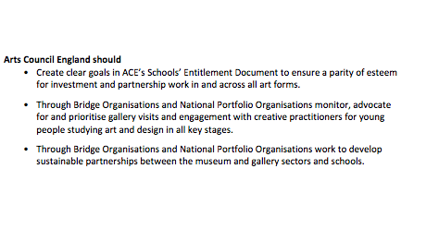
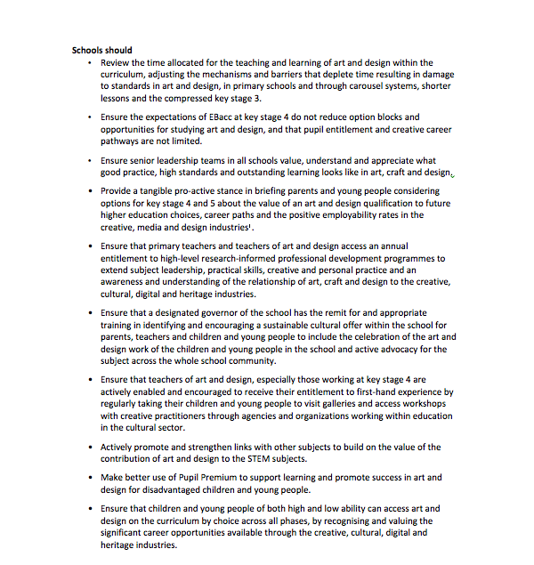
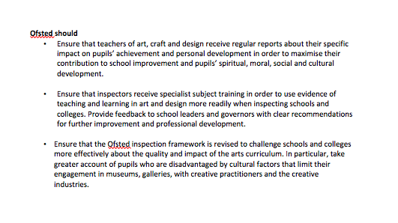
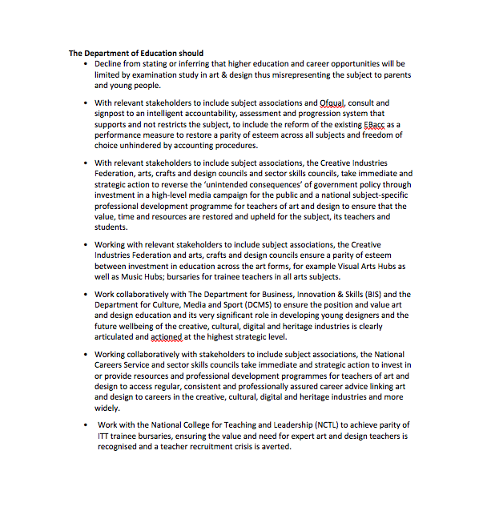
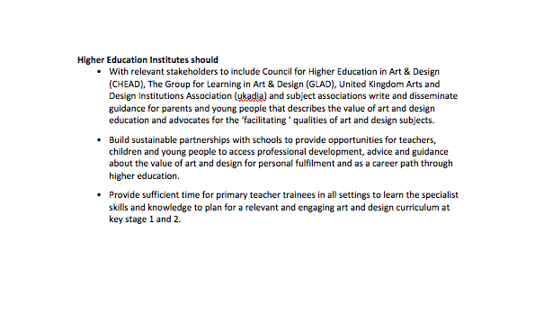
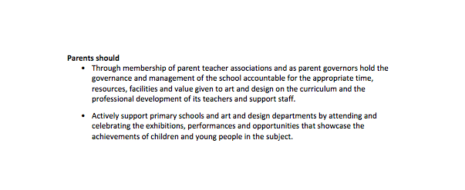
The NSEAD Survey Report 2015-16
nsead.org/downloads/survey.pdf #nseadsurvey
Recommendations
Notes:
We did not want, and we never should be an organisation that identifies problems without attempting to find solutions and NSEAD’s 30 recommendations took forward our concerns and provided strategies for schools, parents, Ofsted, higher education institutions, Arts Council England, and The Department for Education to act on. On the day of the launch we circulated the report to the VCs of all the HEIs engaged in the arts, to MPs, creative industry CEOs, to head teachers, to the directors of art galleries and arts organisations and local government CEOs to name but afew
So what has happened since.

Slide 9
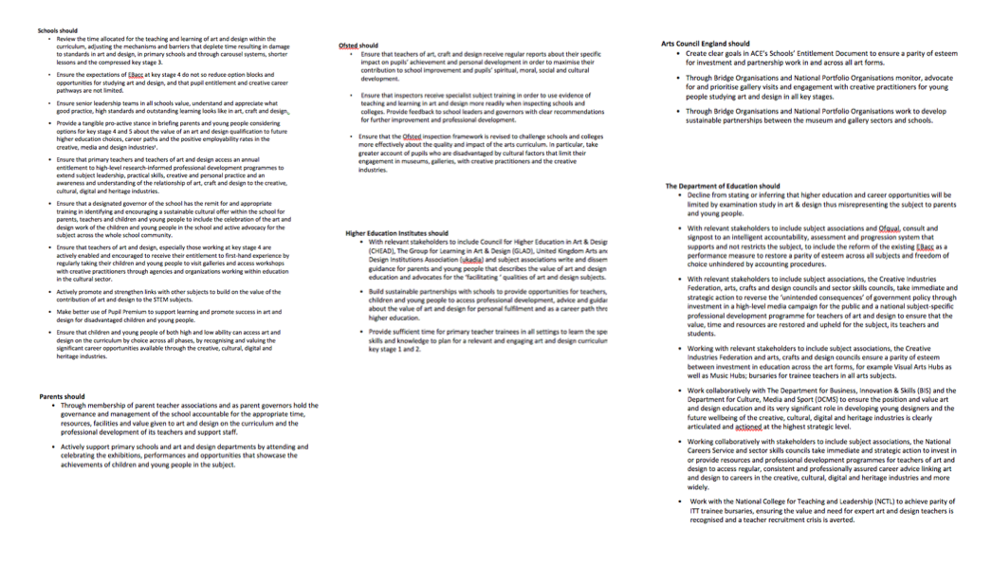
Recommendations
Schools should…
We have been invited to disseminate the evidence of the NSEAD Survey Report at conferences around the country to include the Hampshire Teachers Conference and the first Widening Participation Conference at the University of Brighton
An article is under preparation for IJADE and will be disseminated at the IJADE International Conference at the University of Chester
Several Multi Academy Trusts and Teaching School Alliances have invited the Society to deliver subject specific CPD

Slide 10
Recommendations
Parents should…
The Parent Teacher Association UK, and National Governors Association have both taken an interest in the findings and are willing to meet and work with us

Slide 11
Recommendations
Ofsted should…
No response yet from Ofsted. Mindful of the change of Chief Inspector, the post now occupied by Amanda Spielman, we have re-sent the NSEAD Survey Report alongside our comments of the GCE/GCSE results 2016

Slide 12
Recommendations
Higher Education Institutions should…
We have met with delegates to include the Council for Higher Education in Art & Design (CHEAD), The Group for Learning in Art & Design (GLAD), United Kingdom Arts and Design Institutions Association (Ukadia), the Higher Education in Art and Design Trust (HEAD Trust) and the Guild for Higher Education, (GuildHE) who are actively discussing investment and action as a direct response to the NSEAD Survey Report

Slide 13
Recommendations
Arts Council England should…
The NSEAD Survey Report findings were presented to the Expert Group for Cultural Education hosted by the Arts Council.
Sir Nicholas Serota, NSEAD patron and Chair elect of the Arts Council sent a personal response to the NSEAD Survey Report.

Slide 14
Recommendations
Department for Education should…
The DfE have acknowledged but not shared our concerns

Slide 15
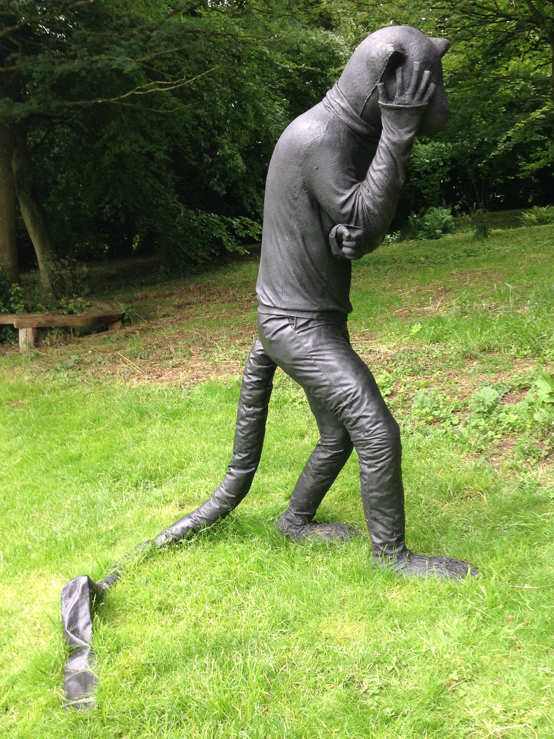
Art, craft and design education:
Celebrating and amplifying our subject
#nseadsurvey
Artist

Slide 16
NSEAD Policy Watch and Strategic Plan
The Society will seek to improve and enhance national perceptions of art, craft and design in the public domain, again, prioritising working with new stakeholders to include parents, governors and head teachers and the media, balancing a need for greater definition without over prescription
To quote Darren Henley, CEO of Arts Council England, we must ‘shine a light on the arts’
Cover image. Laura Ford

Slide 17
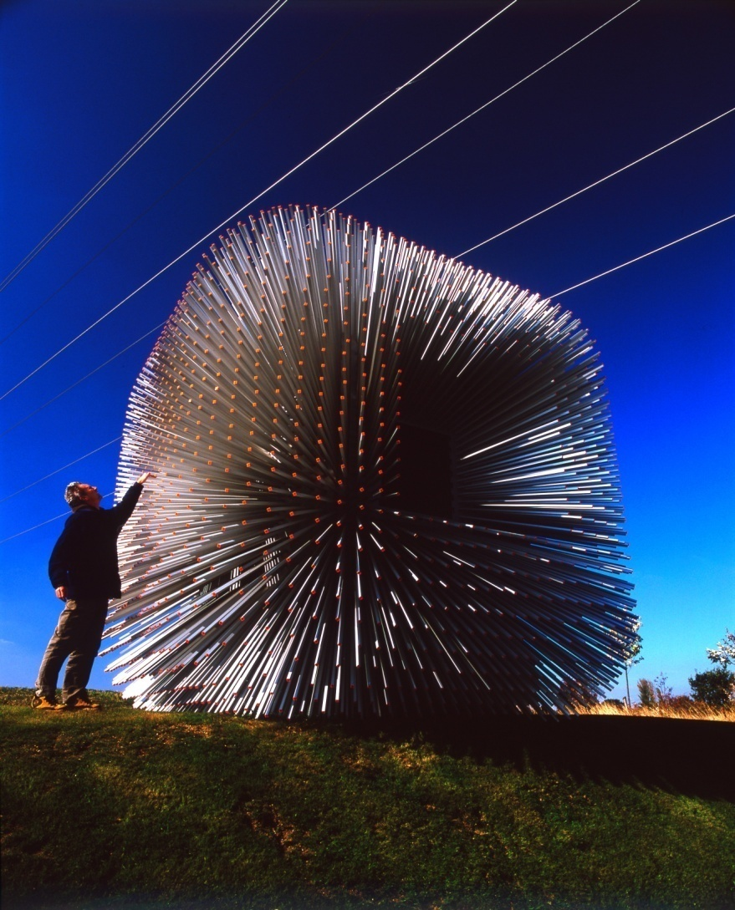
Art, Craft and Design
Design is what links creativity and innovation. It shapes ideas to become practical and attractive propositions for users and customers. Design may be defined as creativity deployed to a specific end
Sir George Cox, Design Council
Image. Thomas Heatherwick

Slide 18
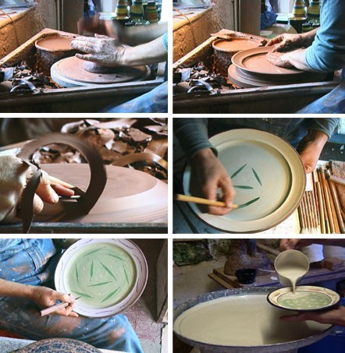
Art, Craft and Design
Craft can be defined as the designing and making of individual artefacts, encouraging the development of intelligent making, intellectual, creative and practical skills, visual sensitivity and a working knowledge of tools, materials and systems
NSEAD 2000
Image: Joanna Stillman

Slide 19
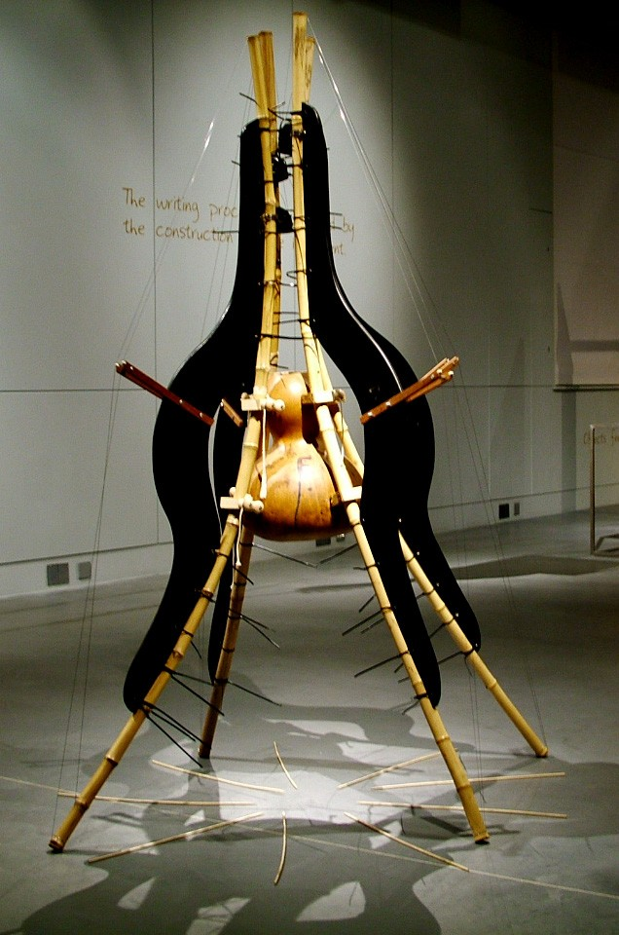
Art, Craft and Design
The NSEAD believe that a world class art, craft and design education provides and inspires personal expression, cultural understanding, creative and practical responses, promoting imaginative risk taking to provide solutions to our material, emotional, social and virtual worlds. A world class art, craft and design education will engage, inspire and challenge pupils, equipping them with the knowledge and skills to participate in, experiment with, invent and create their own works of art, craft and design. Pupils should be able to think creatively and critically. They should investigate and evaluate a wide range of creative outcomes from past and present to develop rigorous understanding of the many disciplines within art, craft and design and how they shape our history and our future. This will enable pupils to contribute as confident citizens and future professionals to the culture, creativity, economic success, leisure, material and emotional well being of our society within both national and global contexts.
Image. Victor Gama

