Slide 1
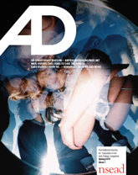
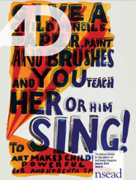
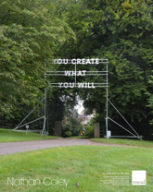
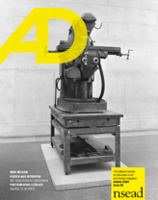
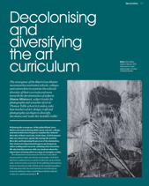
AD magazine and posters: 10 years, 30 issues Your collective achievement: Inspiration – actions – change
2011
2021
Notes:
What is AD? AD is the art, craft and design educators’ magazine, published three times a year – delivered to the doors of members and subscribers. If you are a member or subscriber here today, thank you – you make AD possible.
A shout out also goes to every author (so many I’ve not been able to include until the end two slides) but thank you for your invaluable contributions. You might be an art educator, patron, partner or parliamentarian. I wish I had 30 mins for 30 issues, not 10 mins for 10 years.
This will be a super-fast, whistle-stop tour of AD set within ten years of policy and advocacy driven changes. I hope we can do justice to what you’ve collectively and individually achieved – let’ take a look

Slide 2
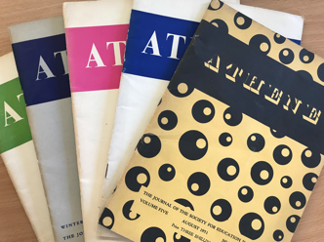
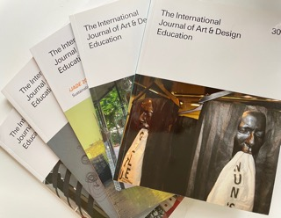
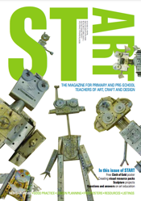
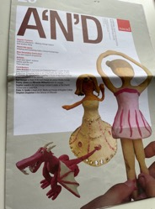
Pre-AD: NSEAD’s publications
1939-79
Athene
iJADE 1982-present…
2010
Notes:
Our NSEAD publication family, sisters, brothers and parents of AD.
Athene magazine 1939-79 - Herbert Read - editor board, and
Henry Moore founding patron, of iJADE

Slide 3
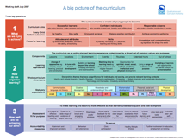
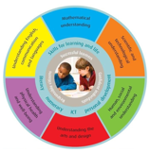
Pre-AD: politics and policy changes
Curriculum for Excellence
Rose Review of the Primary Curriculum
2008 New Secondary Curriculum
2008
2010
2011
Notes:
The political landscape, the breakthroughs
2008 –the launch of the new secondary curriculum; C for E was implemented in Scotland. No sooner had the Rose Review been launched, the newly formed coalition government published the schools white paper for education – it set the scene for what was to follow. The writing was on the wall

Slide 4
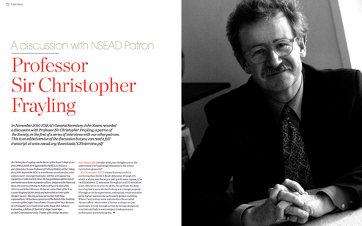
AD #1 Taking inspiration from our history and looking ahead to the future
2010
2011
Notes:
In issue one…
Sir Christopher Frayling mentioned that China was building 1200 art colleges – whilst John Steers mentioned the Ebacc - a performance measure that excluded arts subjects.

Slide 5
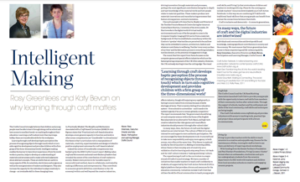
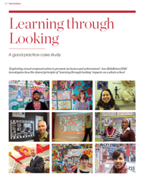
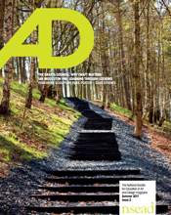
AD #2 Subject advocacy – the importance of making and visual literacy
2011
Notes:
We needed advocacy and we needed it in spades: Rosy Greenlees, exec director and Katy Bevan, learning manager at the Crafts Council examined the importance of teaching, Ian Middleton, then HMI for art and design, the importance of looking.

Slide 6
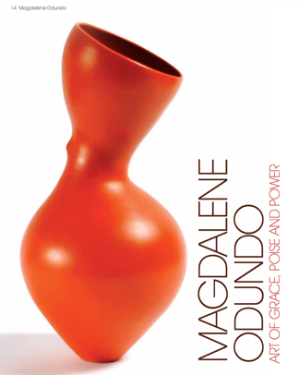
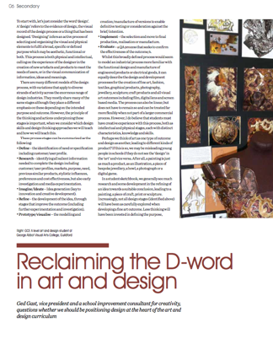
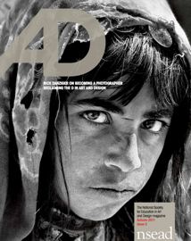
AD #3 Subject advocacy – why art, craft and design
2011
Notes:
In issue 3 Simon Olding and our patron Magdalene Odundo continued to explore the value of making – while Ged Gast reminded us of the importance of The D word, the D word for design

Slide 7
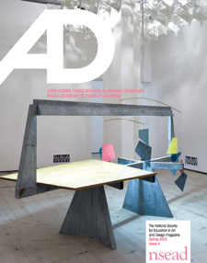
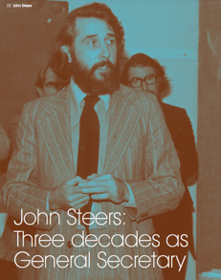
AD#4 Guidance, support and advice Professional body, learned society, and trade union
NSEAD has ‘influenced practice and policy …. supported members in their careers and offered support as a trade union’
2012
Notes:
Dr John Steers retires (after 30 years), but not before sharing and reminding us of the need to have a national and international voice, to influence policy and practice.

Slide 8
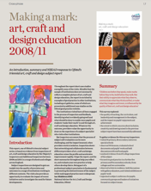
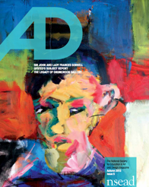
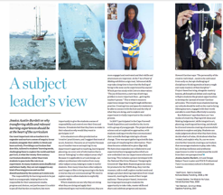
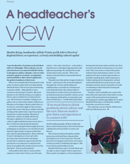
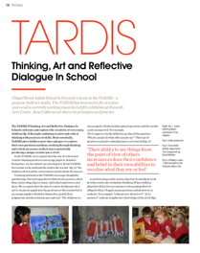
AD #5 Evidence and definitions of best practice - locally
2012
Notes:
….and every single AD helps us to do just that. Every issue includes a wide range of voices, evidence and definitions of best practice. Teachers, HMIs, heads, head of art… all sharing the positive impact of our subject in their settings.

Slide 9
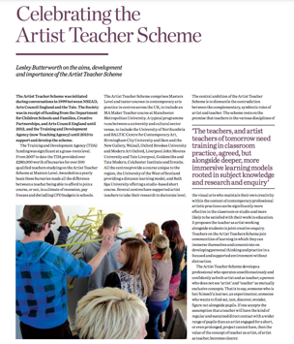
AD #5 Definitions of best practice – nationally
2012
Notes:
We regularly share our patrons’ views, here Sir John and Lady Frances Sorrell, shared the early seeds of an idea for The Saturday Art Clubs. Lesley Butterworth, celebrated the Artist teacher Scheme – first formed by NSEAD and now firmly rooted into many HEIs.

Slide 10
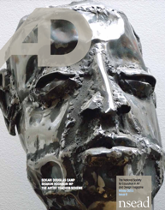
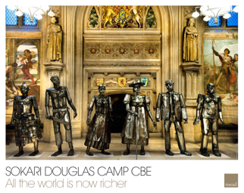
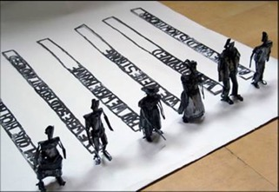
AD #6 Voices for equity
Sokari Douglas Camp
All the world is now richer Exhibited in Westminster –
‘….you need to remind the world that people of black heritage were used as building blocks for cities like the city of London, Bristol and Liverpool. The greatness of England is an echo of these people’s suffering.’
2013
Notes:
We pride ourselves on celebrating the achievements of artists, makers and designers and every magazine comes with an A2 poster.
This poster shows the work of Sokari Douglas Camp CBE. Titled ‘All the world is richer now’, the work reminds us that the privileges of today, all that we take for granted, are due to enslavement in the past.
[The last man is in jeans and a t-shirt and has a little pot-belly because he’s a twenty-first century man, and obviously spends time on his iPad and computer and doesn’t have to wear suits or a uniform of any kind as he is truly freed from all that sort of thing. …behind the t-shirt man the words are: ‘All the world is now richer’ because you need to remind the world that people of black heritage were used as building blocks for cities like the city of London, Bristol and Liverpool. The greatness of England is an echo of these people’s suffering and the world should recognise that.
Our freedoms. The freedoms we take for granted were built or possible due to other people’s suffering – people of black heritage were used as the building blocks for cities like London’. This is away of saying: the privileges we take for granted are due to the enslavement.]

Slide 11
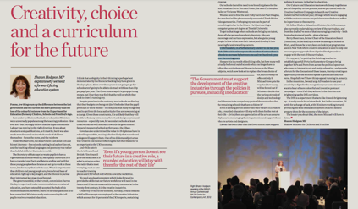
AD #6 Voices for our subject
The first APPG meeting
Sharon Hodgson MP, Chair of the APPG for Art, Craft and Design in Education
‘He (Nick Gibb) expects the number of art teachers in schools to decrease by between one and two hundred a year.’
But, between 2011-17, numbers of art teachers fell year on year by 350 and have only just started to pick up again.
2013
Notes:
…Then Susan M Coles met, Sharon Hodgson. And, the APPG was born! We are hugely grateful to the formidable Sharon Hodgson – 8 years of chairing our APPG.
(Notes as above)

Slide 12
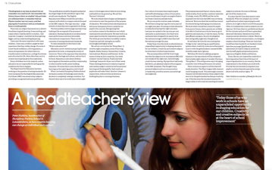
AD #7 Voices for the arts
– Heads for the Arts
Peter Nutkins – Head teacher and now photographer
An Ebacc u-turn: No longer a certificate.
‘…But the Ebacc league table measure is still hanging around.
2013
Notes:
Another art champion is former head teacher Peter Nutkins. He had noticed that the Ebacc certificate had be u’turned but the Ebacc league table measure would still be hanging around. He said ‘This seemingly innocent measure still divides between those subjects that were to be the gold standard and keeps creativity out. If this becomes the standard measure for league tables it will erode the standing of creative subjects in schools.’

Slide 13
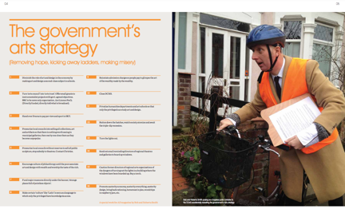
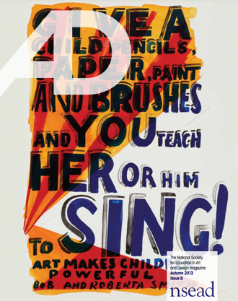
AD #8 ‘The Government’s Arts Strategy’
‘Promote austerity economy, austerity everything, austerity design, bring back rationing,
Turn the lights out, Buy a torch’
2013
Notes:
More advocacy was needed: We are grateful to Bob and Roberta Smith, NSEAD patron, for his wry but nailing it Gov Arts Strategy ‘Promote austerity economy, austerity everything, austerity design, bring back rationing, Buy a torch’!!

Slide 14
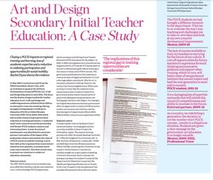
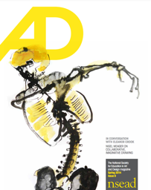
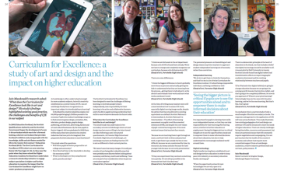
AD #9 Measurable impact of policies – UK wide
Falling numbers of ITE trainees and closure of PGCE centres
Curriculum for Excellence impacting well on HEI
2014
Notes:
Measurable impact of policies – UK wide – Dr Rachel Payne documented the impact on ITE – her case study showed the impact of PGCE art and design course closures – on individuals and communities. Iain Macdonald that CfE was embedding well and impacting on the pipeline into Higher Ed.

Slide 15
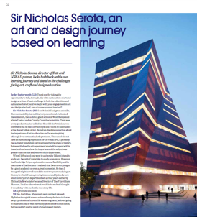
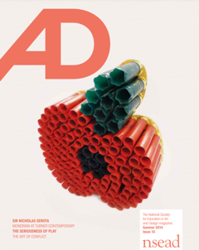
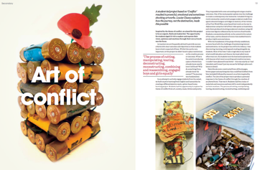
AD #10 National Curriculum 2014
Sir Nicholas Serota, NSEAD Patron, described a playing field for learning and culture that isn’t level
2014
Notes:
Sir Nicholas Serota, NSEAD Patron, described a playing field for learning and culture that isn’t level.

Slide 16
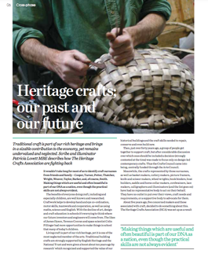
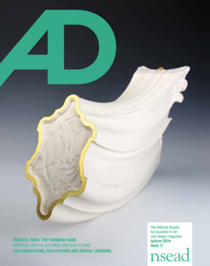
AD #11 Looking back and looking ahead
2014
Notes:
Next up, Patricia Lovett MBE – who shared the importance of heritage crafts for formal and informal learning

Slide 17
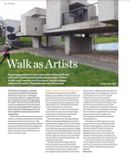
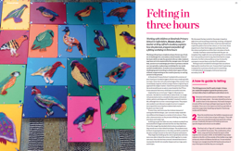
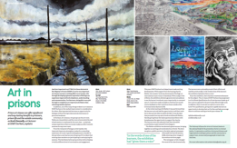
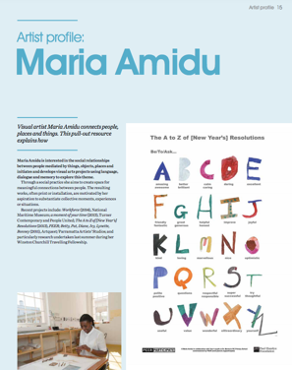
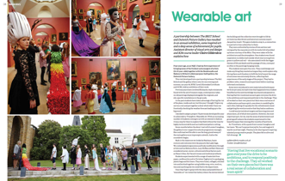
AD #12 Parallel NSEAD Curriculum: All ADs share showcase: projects, plans for all phases and sectors
2015
Notes:
NSEAD had by now produced a parallel curriculum …Projects, inspirations come in a wide range of forms – we believe despite not because of the DfE’s (back of an envelop) curriculum.

Slide 18
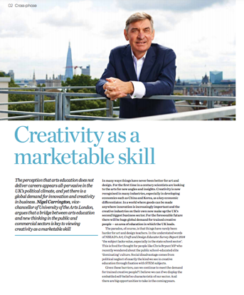
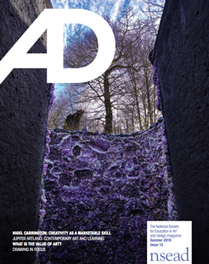
AD #13 Celebrate our subject – marketable skills
2015
Notes:
Sir Nigel Carrington – explained why creativity is a marketable skill

Slide 19
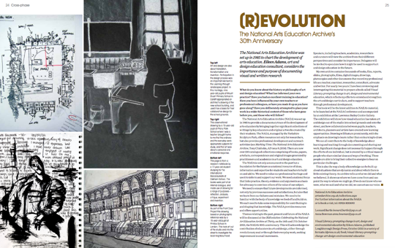
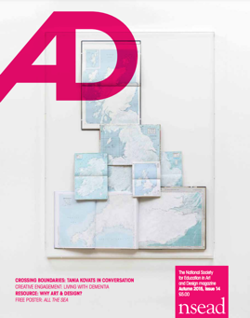
AD #14 The history of art education and agents of change
2015
Notes:
Eileen Adams - celebrated 30 years of the National Arts Education Archive

Slide 20
AD #15 Art agents of change – people, places and projects
Partners – Roche Court
Students – OBU
Schools –
St Marylebone School
2016
Notes:
We also celebrate the people, partners and students who are art agents of change:
Roche Court examine the importance of thinking and speaking about art
Rachel Payne – to encourage young learners to consider today’s political issues, social concepts and theoretical questions
Steph Cubin: ‘Window on the world’ St Marylebone School

Slide 21
AD #16 Evidence sharing – past, present and future
2016
Notes:
WE investigated and evidenced the impact of policy changes on our subject and published the large scale NSEAD survey

Slide 22
AD #17 New ways of working in a landscape of change – Brexit
2016
Notes:
With Brexit around the corner, set to impact on the next generation – Derby High School share their amazing film – Don’t Steal Our HeARTs Ms Morgan.

Slide 23
AD #18 Community and collaborations
2017
Notes:
We celebrate and share partnerships and connections made through out subject

Slide 24
AD #19 ‘You’re a life saver’ – Our subject our teachers
2017
Notes:
AD #19 ‘You’re a life saver’ and we saluted the healing power of Art and Design – art rooms and teachers

Slide 25
AD #20 Snap Election
2017
Notes:
2017 – the year of the ‘snap election’ and we interviewed our patron, Cornelia Parker; and Trevor Horsewood shared the fall and rise of the History of Art A level

Slide 26
AD #21 130 years of NSEAD and young people’s voices
2018
Notes:
In 2018 NSEAD was 180 years old – we dedicated this issue to the next generation of artists, designers and makers.

Slide 27
AD #22 Every author is a champion for our subject
2018
Notes:
We shone a light on the need for local activism.
Hilary Gresty: In 2017, Norwich University of the Arts commissioned a survey to assess the impact of national policies on local art, craft and design education: ‘Pupils from disadvantaged backgrounds in particular have fewer opportunities to develop the, often extra-curricular, skills that ease the path to higher education’

Slide 28
AD #23 The Advocacy issue
2018
Notes:
We needed advocacy –issue 23 is our subject advocacy issue. The pull-out resource and poster are now free for all to download from our website.

Slide 29
AD #24 The gender and inclusion issue
2019
Notes:
In 2019 Lesley Butterworth had stepped down as NSEAD GS, and Michele Gregson was appointed as NSEAD GS. #24 is the gender and inclusion issue = we reported on the gender divide in art and design – Susan Coles shared how we can make the subject more gender inclusive.

Slide 30
AD #25 The interdisciplinary issue
2019
Notes:
Young Arts Leaders interviewed our new patron – Keith Brymer Jones
This issue dug deep into the long marriage between art and science subjects.
Deirdre Robson and Ivor Hickey, The Leonardo Effect developers
Paul Carney, Put forward theargument that visual art is intrinsic to innovation, invention and discovery in all STEM subjects
Fay Penrose, senior lecturer in veterinary anatomy - argues that the false division between art and science in the UK is detrimental to the acquisition of visual and haptic skills needed for veterinary science

Slide 31
AD #26 Communities make art – art makes communities
2019
Notes:
26 we returned to community as a theme: Where communities make art and art makes communities.
Peter Gregory interviewed Katie Paterson
Sarah Philips - Japanese art – how art shapes communities
Claire Penketh - Above all, the painting and greening show that this place is valued, and that these are visible acts of care’
Elinor Brass and Susan Coles Susan Coles, reflects on the Circle’s past and its more recent explorations in Berlin
Sue Armitage, devised a system of bringing observational drawing into the whole school community - the assembly hall

Slide 32
AD #27 Access to art, craft and design AND D&T
2020
Notes:
In 2020 – pre pandemic at least here in the UK - we are celebrated the distinctness of art, craft and design AND D&T, as well as being complementary with each other and other subjects
Michele Gregson – art and design and D&T are a distinct entitlement
After nearly ten years of social mobility focussed policies, social inequalities have in fact widened. Dr Rachel Payne argued that our subject can help reduce such inequalities and that access to art, craft & design education is not an issue of social mobility, but of social justice
2020 – the start of our regular series – Therehold Concepts in art and design – Chris Francis explores each threshold concept , always in his creative and mischievous way

Slide 33
AD #28 Art, environment and sustainability
2020
Notes:
Unsurprisingly, the authors in this issue were commissioned to write their features before the Covid-19 outbreak, having responded to the issue’s proposed themes of art, environment and sustainability. Thank you for your writing and ALL your rewrites. This included Dr Janina Ramirez, our most recent patron who has joined our amazing NSEAD family of patrons.

Slide 34
AD #29 Covid and new ways of learning and working
2020
Notes:
By Sept 2020 everything had changed. We ere able to share our community responses to the pandemic – stories of resilience, of will, how gallery and museum learning departments had (moved online, how they along with schools were adapting to online and blended learning – how teachers were painting portraits of NHS staff and making PPE equipment. It includes an article on teacher and learner wellbeing which I’d encourage everyone to read.

Slide 35
AD #23 AD’s birthday – we’re 10 years old! Art and actions which make the world a better place
2021
Notes:
Then comes our birthday issue. Whilst this issue celebrates 10 years of AD, it also celebrates the artists and educators whose actions make our subject more inclusive – this issue, indeed every issue, shows the positive impact our subject has on individuals and communities everywhere.

Slide 36
Back stage
NSEAD Council and Forum – please keep the ideas coming
Steers McGillan Eves – designers
Helen Adkins – production editor
NSEAD officers and staff
John Bowden 1941-2012 – A’n’D and AD co-editor
Notes:
Before we end, please bear with me, I want to give a brief shout out the our amazing back stage team – the brilliant designers at Steers McGillan Eves; Forum and Council for your ideas and themes, Helen Adkins for your excellent production and copy editing; NSEAD officers and staff for helping with, well everything…and John Bowden, who helped edit AD in the first few issues, but who passed away very suddenly in 2012.

Slide 37
Every author – thank you for sharing your ideas, provocations and celebrating our subject – you change lives (1/2)
#30 Yinka Ilori Fiona MacDonald Chris Francis Features 07 Decolonising and diversifying the art curriculum Dianne Minicucci Joanna Neil Amber Smith Michele Gregson Dr Deborah Riding Marenka Thompson-Odlum Toby Parkin Harriet Dunn Anna Robb Linda Copeland Elaine Little Steve Sharp David Gilliver Caroline Smith, Michele Gregson
#29 Lisa Murphy Meg Wellington-Barratt Cat Gibbard Peter S Smith Charli Neal Hannah Day Dr Steven Berryman Bradley Hodgson, Marlene Wylie and Amanda Skilton Stephanie Cubbin and Dr Janna Graham Jane Sillis Lucy Hall Laura Merlin-Warner The LifeAfterLockdown team Mike Nelson
#28 Dr Janina Ramirez Dr Rachel PayneKay GreenleesNatalie Rudd Allison MurdochLucy HallChris FrancisJeff Adams, Sam Rhodes and Claire SmithJames Gardner and Dave WilsonTom Hardy James Aldridge Caroline WheelanMelissa WestbrookAmanda Duke and Katie Duke Jeanette Barnes, Paul Brandford and Charlotte Steel Dr Emese Hall
#27 Michele Gregson Jo SweetingSophie LeachDr Rachel PayneChris Francis Anne-Louise Quinton Sevra Davis Alison Nash Marc Quinn Sarah Phillips Will Grant Miranda MillwardTamar MacLellan and Philippa Wood Melanie Lucking Mary Ealden
#26 Katie Paterson Dr Peter Gregory Dr Claire Penketh Andy AshErin BarnesDr Marsha Bradfield and Shibboleth Shechter Sarah Phillips Gemma Hobbs Elinor Brass and Susan ColesOllie BriggsDebbie HillyerdTabitha MillettSue ArmitageMaggie StewartSam Grinstead
#25 Keith Brymer Jones, Young Arts Leaders from Palm Bay Primary School, Michele Gregson Paul Carne Alex and Amelia Zoe Crockford Lyn French and Georgina Evans Vicky Isley and Paul Smith Fay Penrose Deirdre Robson & Ivor Hickey; Helen Houston-Phillips & Sarah Williams Jayne Phenton Mandy Barrett Etta Voorsanger-Brill Pavilion Sacha Guppy
#24 Huma Bhabha Sophie Leach Susan Coles Zoe Crockford Natalie Deane Patrick McDowell Michele Gregson Meghan Goodeve Sarah Phillips Dr Rachel Payne Ted Fox Joyce Linda Copeland Charli Neal Sinead Dowdall and Charlotte Ball
#23 James Lake Richard Adams Professor Jeff Adams Andy AshNSEAD, our Forum and members Melanie Cox and Mandy Barrett Munira Mira Cara Williams Susan Coles Lisa Jacques Pete Moorhouse Nicola McCaffrey and Lucy Williams
#22 Ryan Gander Lesley Butterworth Susan Ogier Peter Corkish Natalie Rudd and Natalie Walton Nicki Allen and Sarah Barton Jeremy Newton Michele Gregson Dr Jenny Rintoul Simon Huson Jane McDonald Scott Donnelly Graham Hooper Hilary Gresty Sally Johnson Miranda Millward
#21 Zoom Rockman and Susan Coles Mawda Amer Seraphima Kennedy and Louise Gatti Joe Macleod Emma Middleton Ollie Briggs Annabel Johnson Lesley Butterworth Charli Neal Dan Firth-Powell Sarah Phillips Emily Druiff Patricial Lovett MBE
#20 Cornelia Parker, OBE RA, Sophie Leach Sarah Mower MBE Miranda Millward Simon Betts Graham NewmanRuth Robinson Dave Fudge Mari Bradbury and Ivan Davies Sally Johnson and Sam Hobbs Karen Palmer Susan Coles Carla Mindel Francis Murphy
#19 Dominic Wilcox and Dr Rachel Payne. Graham Hooper Lisa Harker Dr Claire Penketh Nicola Currie Sarah Meader Hannah Day Trevor Horsewood Caroline Whelan Dr Melissa Westbrook Karen Palmer Nicola McCaffrey
#18 Kate Holland James Harrison Jim Smithyes Peter Gregory Lesley Butterworth Eileen Adams Ged Gast Cara Williams Kirsten Adkins Michele Gregson Charli Neal Anne-Louise Quinton Nick McKemey Susan Coles Lily Elms Tim Rees-Moorlah Will Grant
#17 Imperial War Museum, London Nic Vanderpeet and Jo Hookes Brockbank Dr Peter Gregory Dr John Steers Graham Hooper Lesley Butterworth Professor Dennis Atkinson , Michal Napieraj and Abbie Trafford Beth Sims Ken Newlan Sarah Baker Terri Newman Andrew Smith Esther Tyler-Ward Gayle Jones Mari Bradbury and Ivan Davies
#16 Bob & Roberta Smith Lesley Butterworth, Tristram Shepard Alison Paton John Kampfner Neil Walton Louise Mackuin Walbottle Campus Create Faculty Steph Morris and Alice Crumpler Rebecca-Louise Leybourne Sara Cooper Mary Wiltshire Rebecca Heaton Manna Dobo Sarah Purvey Carla Mindel
Notes:
My last shout out is to the hundreds of authors, who along with their day jobs, write for AD. Many are authors are writing for the very first time, all are taking the time to share their ideas, provocations and evidence, knowing that our amazing subject can and will change lives.

Slide 38
Every author – thank you for sharing your ideas, provocations and celebrating our subject – you change lives (2/2)
#15 Nathan Coley Jon Nicolls and Chris Francis Jo Baker Dr Claire Penketh Lucy Salisbury, Emma Kerr, Nia Crouch, Josepha Sanna and Francesca Wilson Rachel Payne Lindsey Bennett Steph Cubbin, Pete Thomas and Kat Pugh Vega Brennan Frieda Fox Graham Hopper Lauren Currie Suzanne Chalke Paula Johanne Preston Susan Coles Rebecca Wombell Paul Carney
#14 Tania Kovats Sophie Leach Dan Hopper Jennifer Sharp Peter Gregory Chris Francis Anne-Marie Quinn Steph Cubbin Debbie Heppletstone Anna Pickard Suzy Tutchell and Maria Vinney Eileen Adams Janine Sykes and Sharon Bainbridge Kai Wood Mah Anne Brown and Suzie Parr Jackie Brown and Moira Jarvis
#13 Marc Quinn Patzi Shepperson Jeanette Barnes, Eridge Trust Dr Iain Macdonald Sir Nigel Carrington Caroline Underwood Art, craft and design teachers and educators Contemporary art and learning Diana McMicking Susan Coles Sue Grayson Ford Jenny Robbins Allison Cargill Charli Neal Susan Ogie r and Fiona M Collins Simon Huson Kate Allan Alla Tkachuk Hannah Yason
#12 Morag Myerscough Susan Coles Maria Amidu Helen Ward and Adrian Brookes Patzi Shepperson Susan Coles and Traci Cain Claire Gildersleve Hannah Hames Lesley Butterworth Susan Coles Lisa Robertson Scott Donnelly Rowan Jones Yvonne Jordan Kerry Gibson Amanda Skilton
#11 Michael EdenVega Brennan Bethany Naulls Harry Fisher Michael Eden Patricia Lovett MBE Cara Williams Lesley Butterworth Sarah Green and Meghan Goodeve Ged Gast Nicola Collins Susan Coles, Elinor Brass, Karen Wicks and Georgia NaishKatie Keech Jean Edwards Oliver Reichard
#10 Karen Eslea, Turner Contemporary Andrew Mutter Mikayla Howard Paul Letchworth Annabel Johnson, Annette Krauss, Liz Millward Julia Bennett Naomi Hart Tanja Ganga Louise Clazey Abbie Mccammond and Ben Gnauck Louise Gatti Charlotte Capp, Chet Mistry, Lorayne Southam Adam Hayley Josefin Boren Michael Bradley John Steers
#9 Eleanor Crook and Lesley Butterworth, Tony Chisholm Charlotte Capp Rachel Payne Peter Gregory Liz Collins and Janine Creaye Angela Findlay Nigel Meager Ruth Pritchard Jo Brown Ashia Oozeer Iain Macdonald Lilian Clitheroe Isabel Mullery Nicholas Houghton
#8 Bob & Roberta Smith Liz Macfarlane Mike Jarvis Jamie Rogers Joe Macleod Derek Yates Ged Gast Lesley Butterworth Hilary Gresty Susan Coles Eileen Adams Lauren Carr Debbie Webster and Carolyn Davies Elena Thomas Sarah Plumb Natalie Deane and Fabric Lenny Emma Sutcliffe
#7 Rob Kesseler Peter Nutkins Caroline Corker Jono Carney Peter Gregory Robert Watts Dr Helen Charman Amy Robinson Penny Jones Howard Hollands Hannah HamesTom Procter-Legg Ted Kennedy Ian Lightfoot Carol Wild Anne Brown Paula Briggs and Sheila Ceccarelli
#6 Sokari Douglas Camp CBE Victoria Houghton James AldridgeJessica Austin-Burdett Sharon Hodgson MP Henry Ward, Anthony Williams, Howard Hollands Lucy Taylor-Hall Anne Wilford Michele Gregson Jayne Stillman Kimberley White Beatty Hallas Lesley Butterworth and Christine Egan-Fowler Dan Firth-Powell Susan Coles
#5 Tate collection, Deborah Riding Frances Barry Bella Goggin CoolTan Arts Peter Gregory Graham Jervis Sir John and Lady Frances Sorrell Heather Kemp Jane Calderwood Jonathan Carney Anne-Marie Quinn Ian Middleton Helen McCormick Katie Smith Eileen Adams and Susan Coles Julie Parker Emma Reed and Jim Bradley
#4 BALTIC Centre for Contemporary Art Lucy Smith Greg Hodgson Eileen Adams Billy Rowlinson John Bowden John Steers Susan Coles Michael Jarvis Julia Rowntree and Duncan Hooson Miranda Baxter Iain Macdonald and Richard Firth Charlie Capp Alison Hermon Jill Hedges Amanda Warren, John Steers
#3 Simon Olding Magdalene Odundo Professor Simon Olding Andrew ShobenEileen Adams and Susan Coles Miriam Bridson John Bowden Graham Jervis Nick Danziger Ged Gast Louise Lamming Natalie Deane Michele Gregson Face Britain Ben Frimet June Bianchi Marilyn Kyle Sandy Etteridge and Jill Hedges L esley Butterworth
#2 Akash Patel Anne Wallace Andrew Mutter Christine Egan-Fowler John Bowden Rosy Greenlees and Katy Bevan Ian Middleton HMI Jon Nicholls and Soren Hawes Megs Bailey Susan Coles Susan Ogier Katterine RuddlesdinDr Veronica Sekules John Childs Anna Baker, Richard Hards, Janet Nejo and Rhoda Boateng Penny Jones Peter Wilford and Anne Wilford Frances Akinde Peter Carr
#1 Sir Chris Frayling John Steers British Museum Prof Nick Stanley Susan Coles John Bowden Sophie Bower Patricia McKenna Graham Jervis Mick Walters Robin Widdowson Sam Eyre Kathryn Ashcroft Peter Gregory Helen Brimblecombe Anna Deamer Alison Mawle Penny Hay and Mary Fawcett Susan Ogier
Notes:
Thank you one and all.

