Slide 1
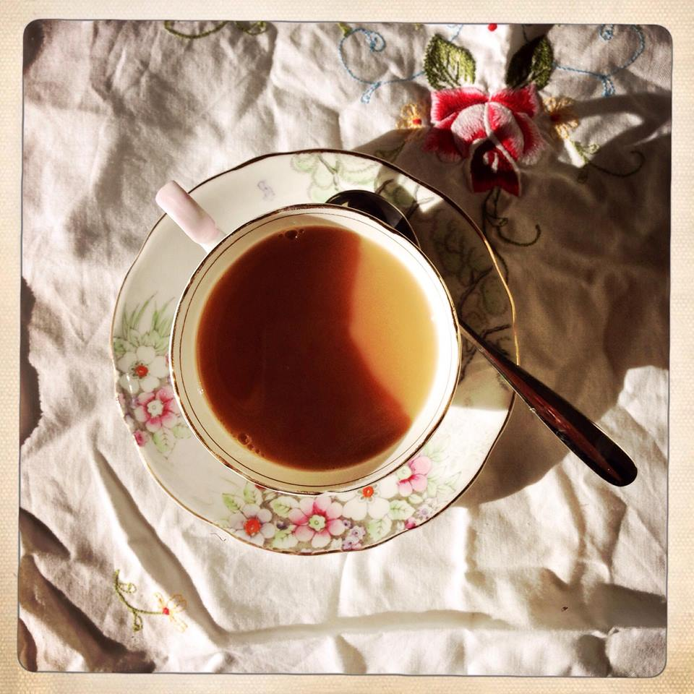
TEA Thinking, Expression, Action
The social media story

Slide 2
#teacpd
Rationale:to use social media platforms to support the work of T.E.A. and develop more social interaction and opportunities for discussion for the educators involved.

Slide 3
June 2012
Audit sent out to gauge experience and willingness with using social media platforms.
Majority willing. Some reluctant.
Inclusivity important so all platforms introduced and email loop also developed.

Slide 4
June 2012
Email loop starts
FaceBook group established
Twitter hashtag created #teacpd
Linkedin group established

Slide 5
The beginning
The summer project was designed to be a non threatening ice breaker- a bit of fun really. This grew into a whole host of other online and mail art projects.

Slide 6
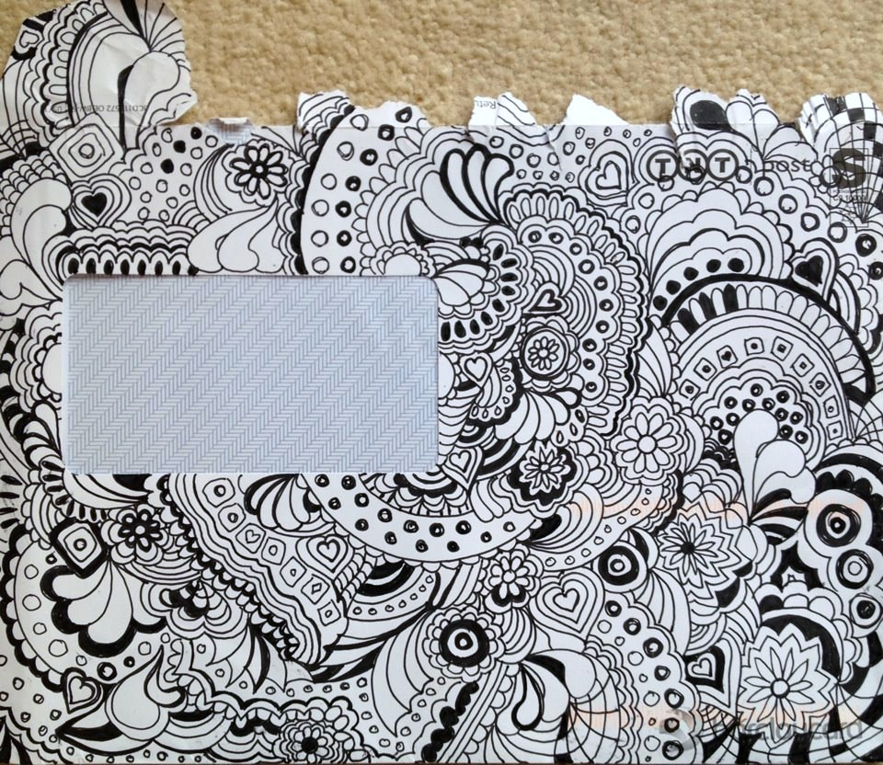
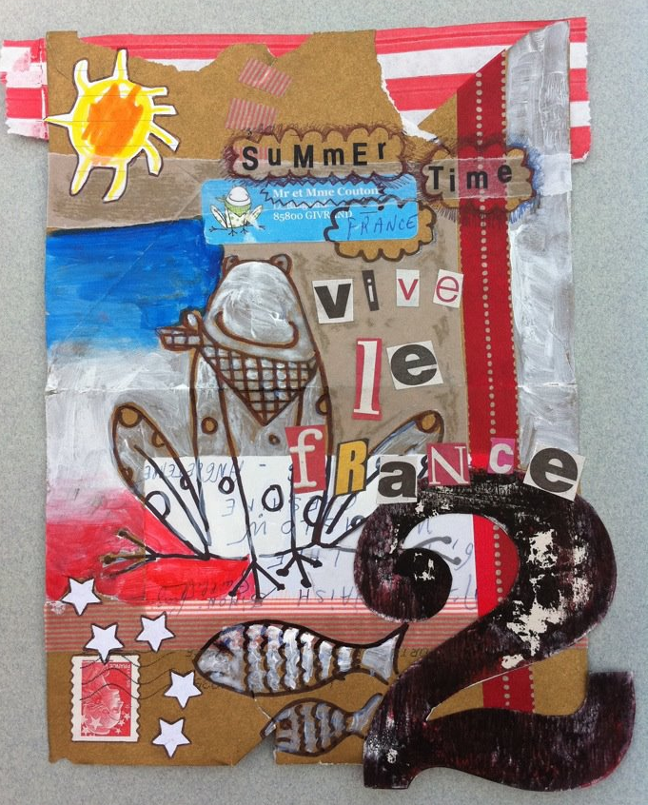
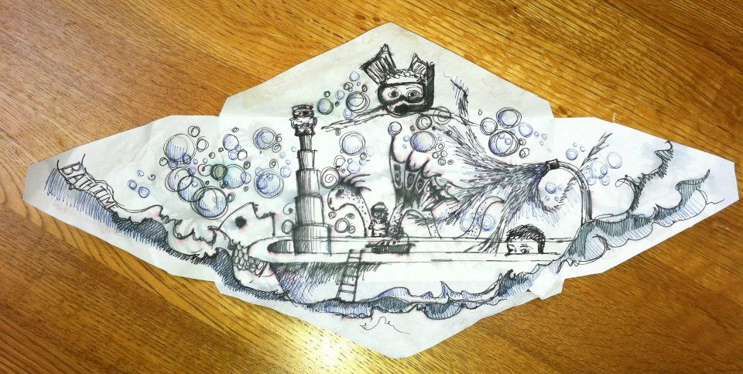

Slide 7
Hundreds of drawings followed...
Introductions
Conversations
Exchange of views
Discussions about drawing
Discussions about assessment

Slide 8
Facebook group most active.
Numbers went from 45 to 76.
Closed group, invite only.
Email loop continued and encouraged participation.

Slide 9
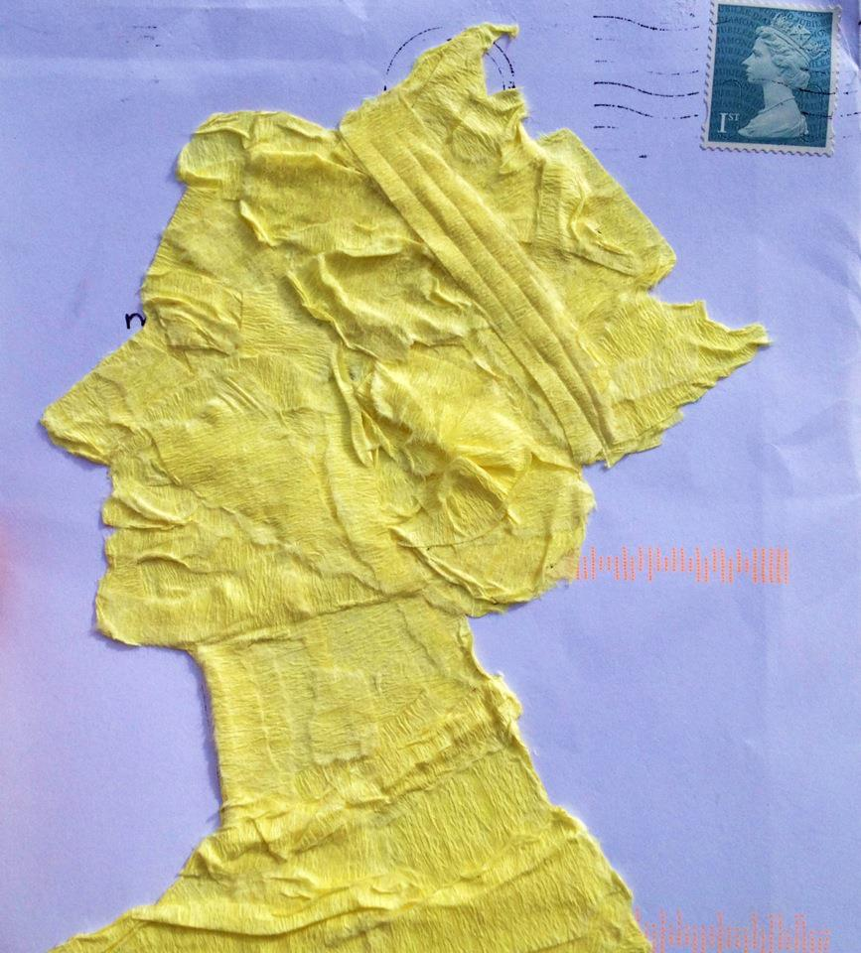
The summer of 2012; more projects

Slide 10
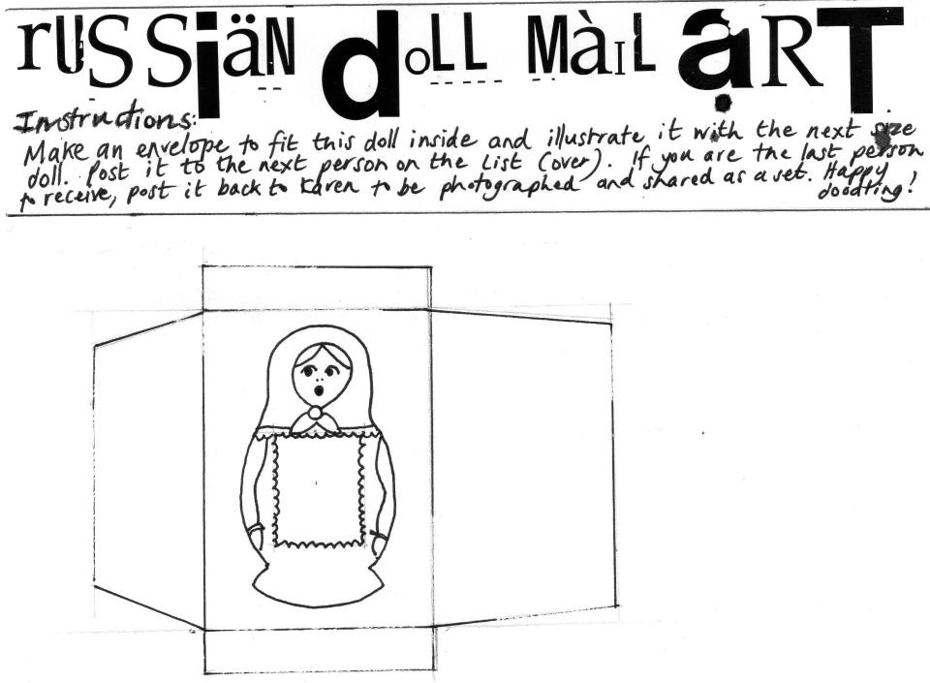
The Russian Doll Project

Slide 11
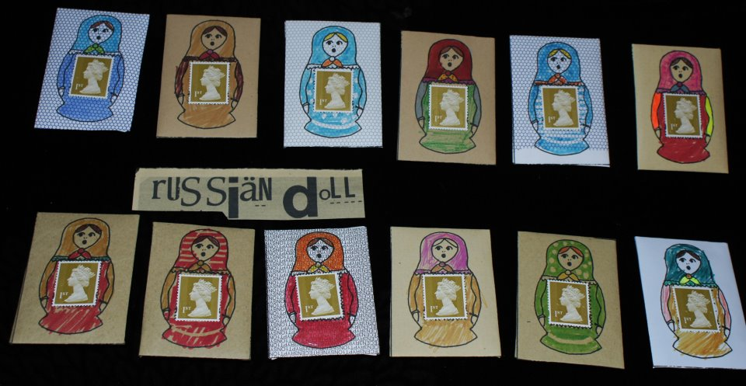

Slide 12
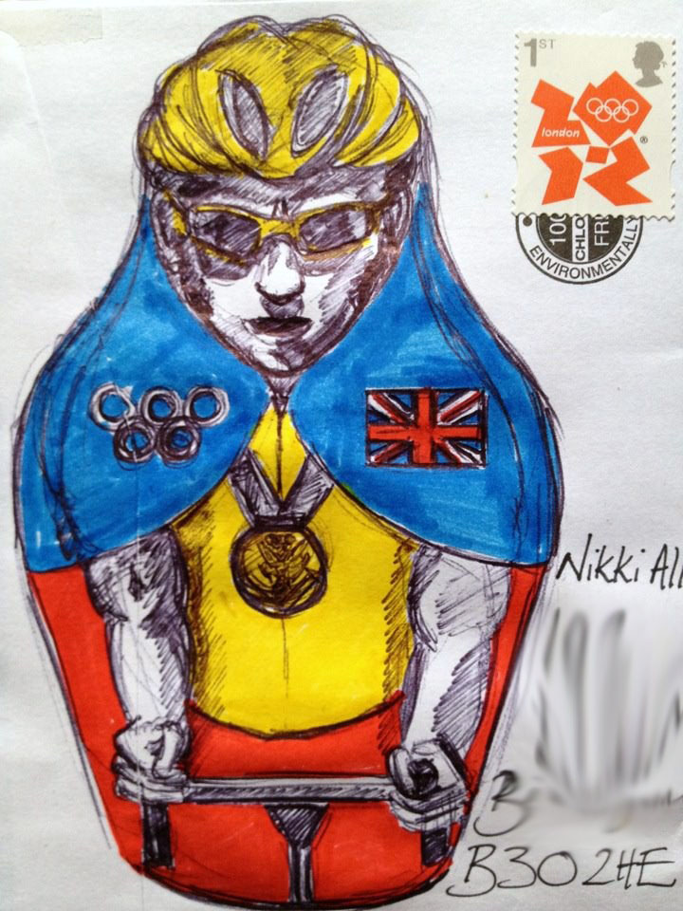
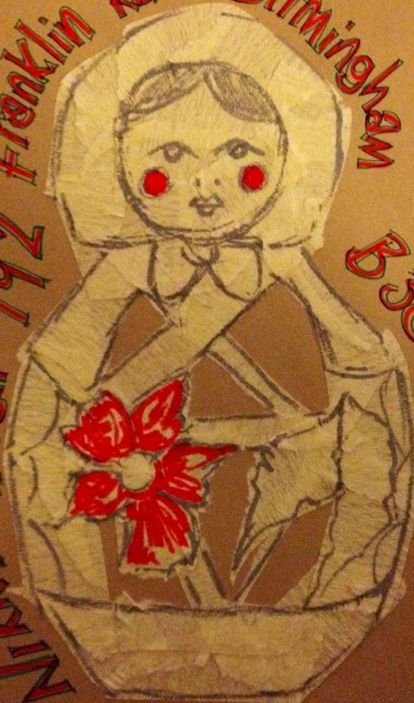
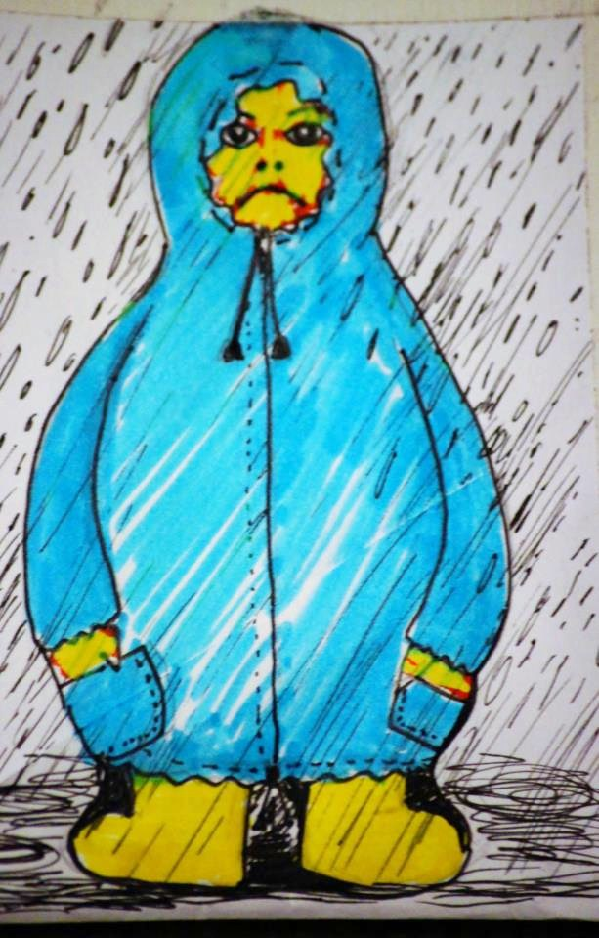

Slide 13
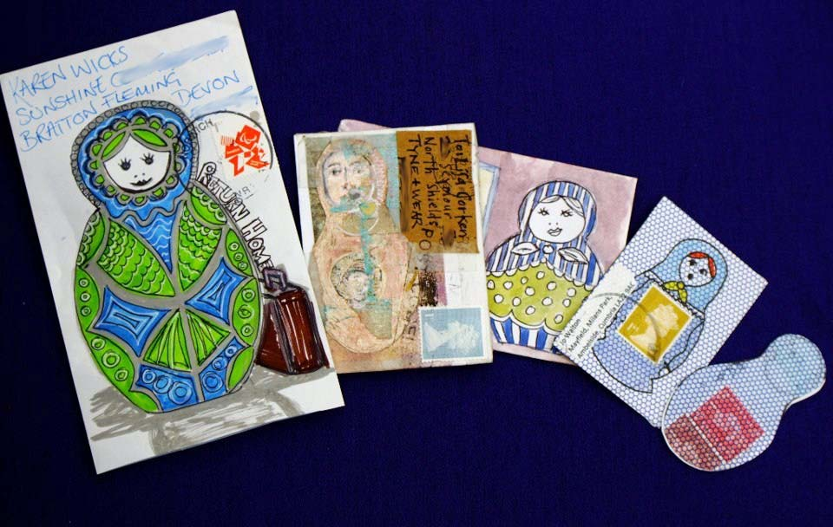

Slide 14
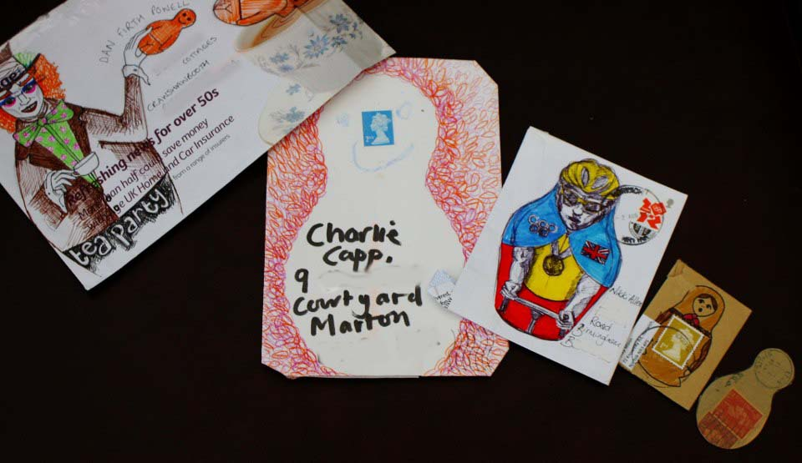

Slide 15
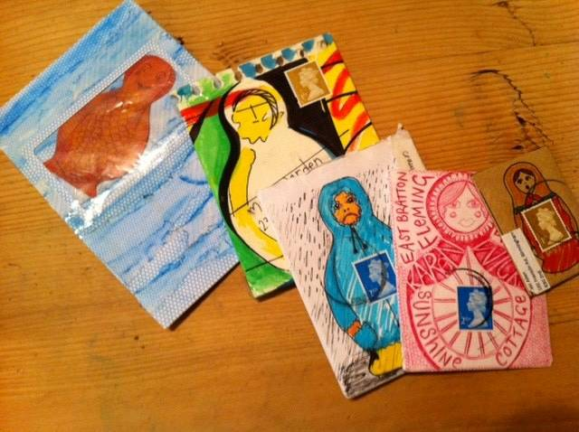

Slide 16
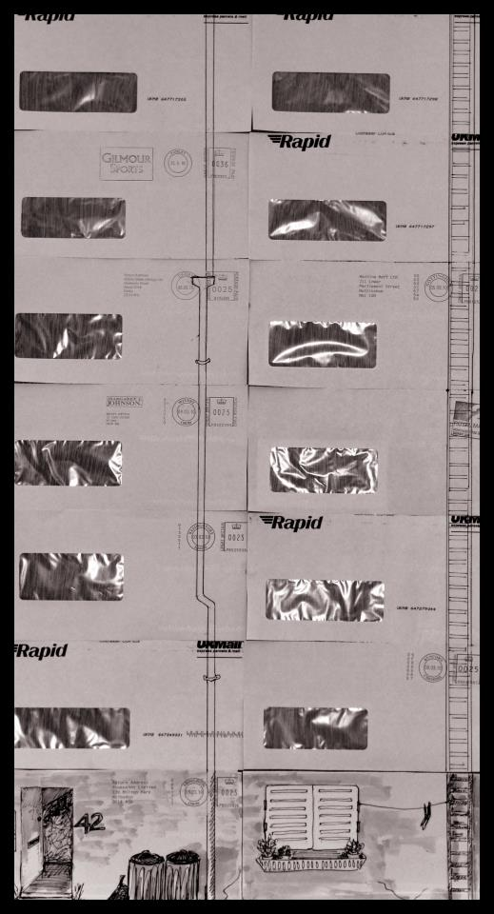
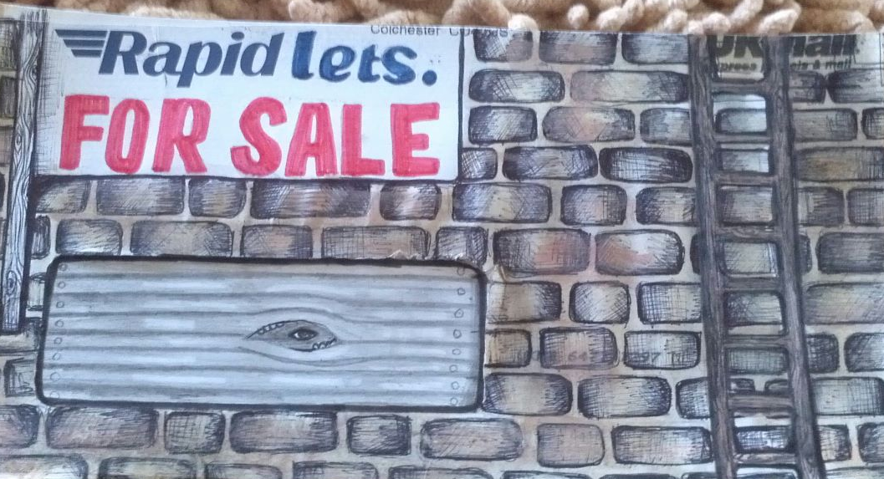
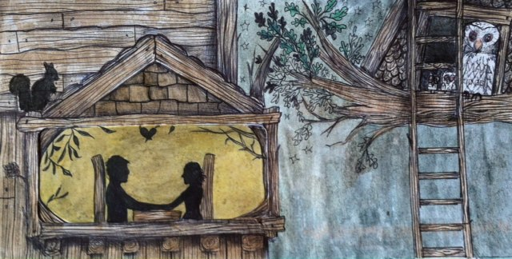
In the tenement project, individual envelopes were collated together to create a tenement block. You started with the white envelope (left)

Slide 19
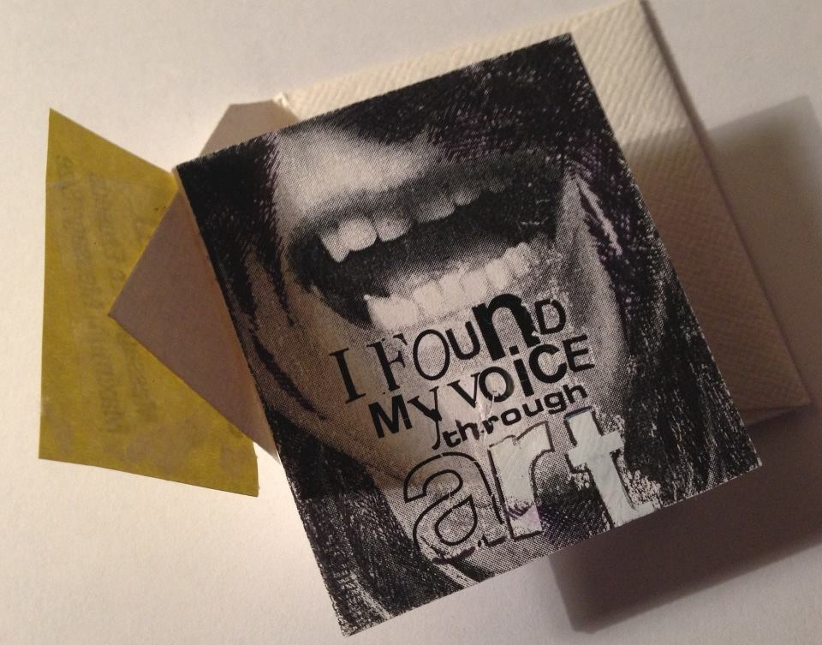
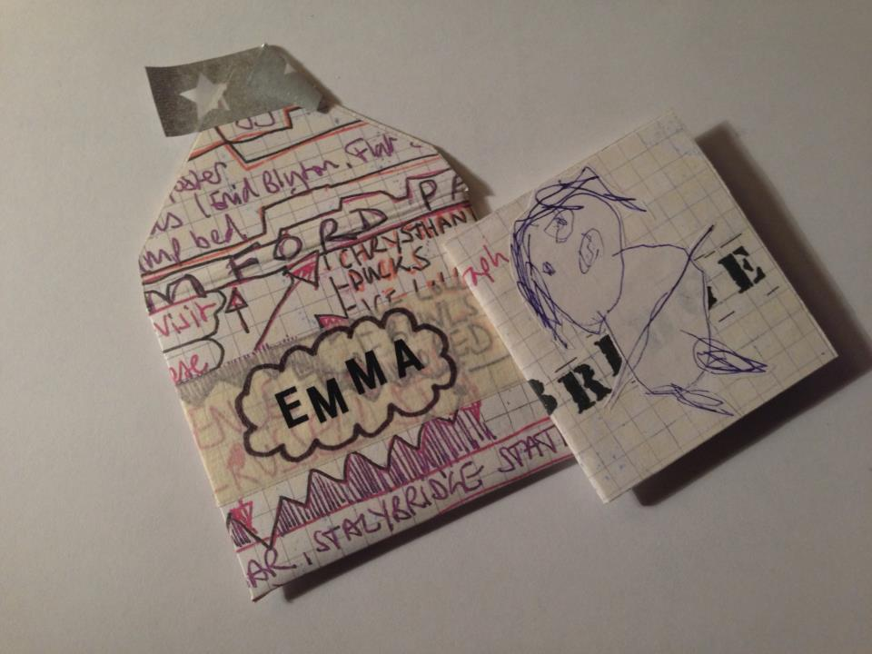
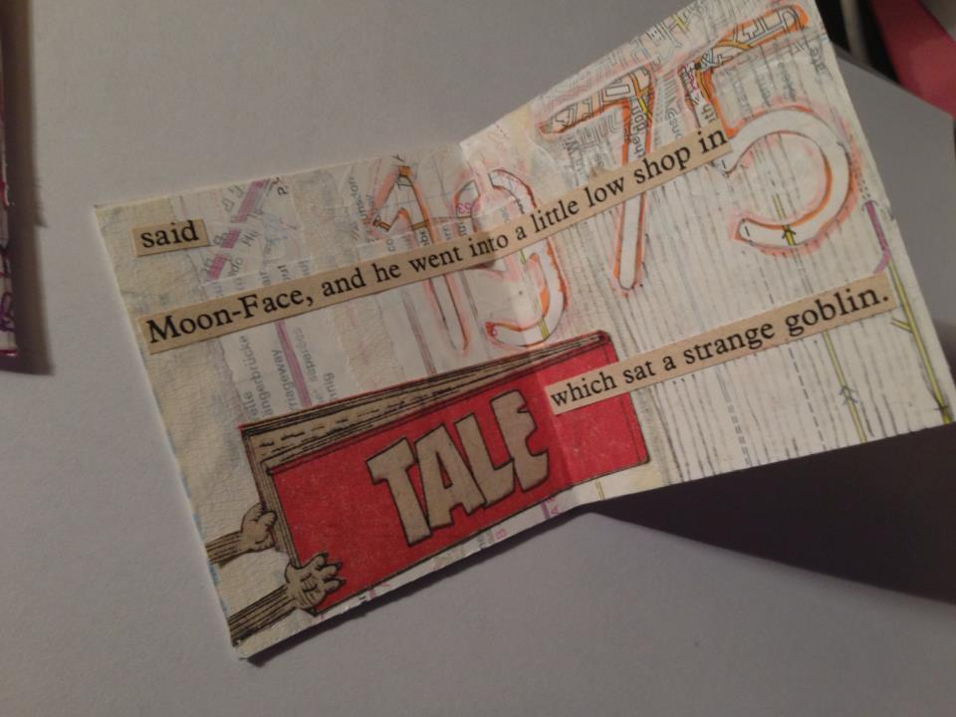
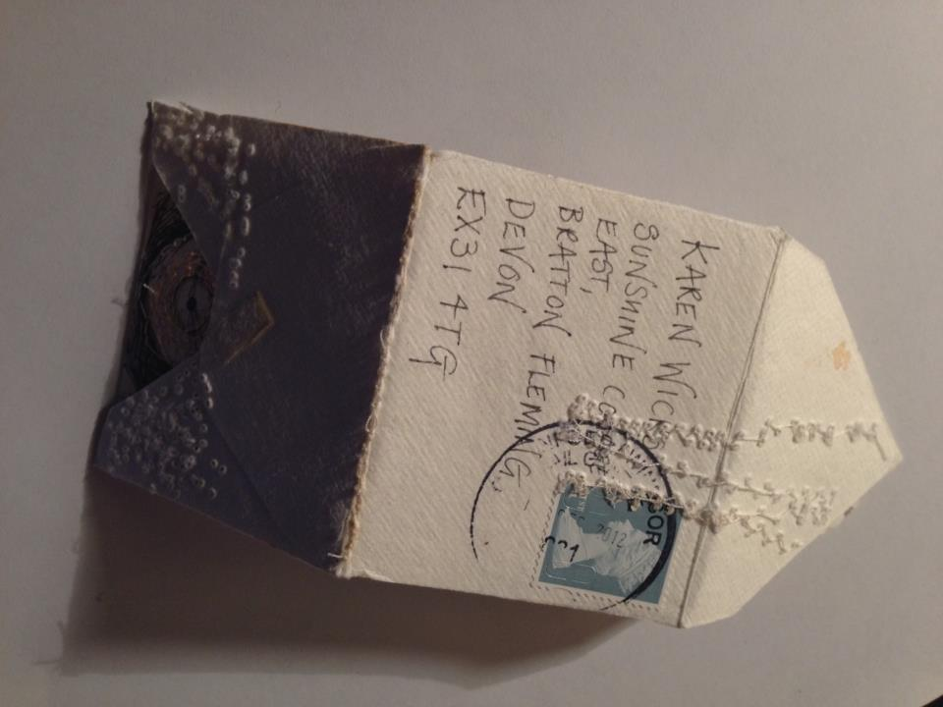
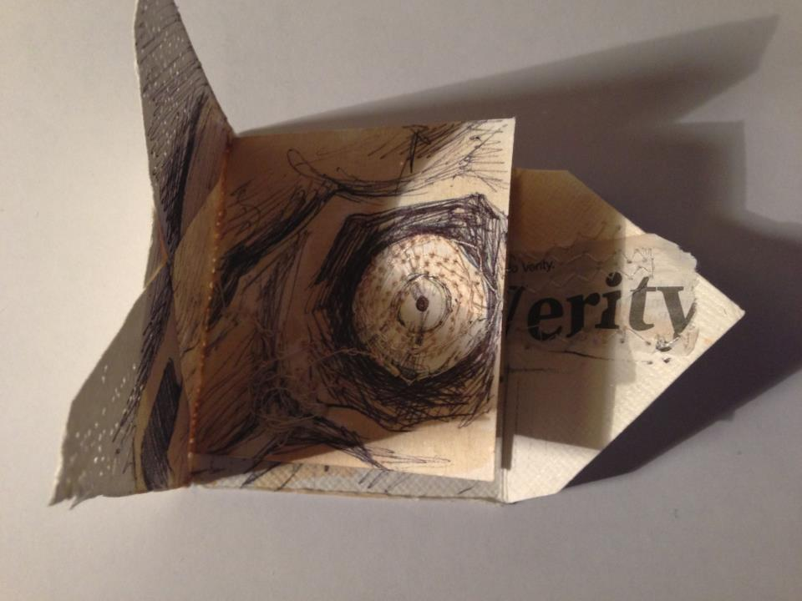
The Mini Me Project
Mini Me project was to create a tiny self portrait in an envelope, not much bigger than a stamp, and these survived posting too!

Slide 20
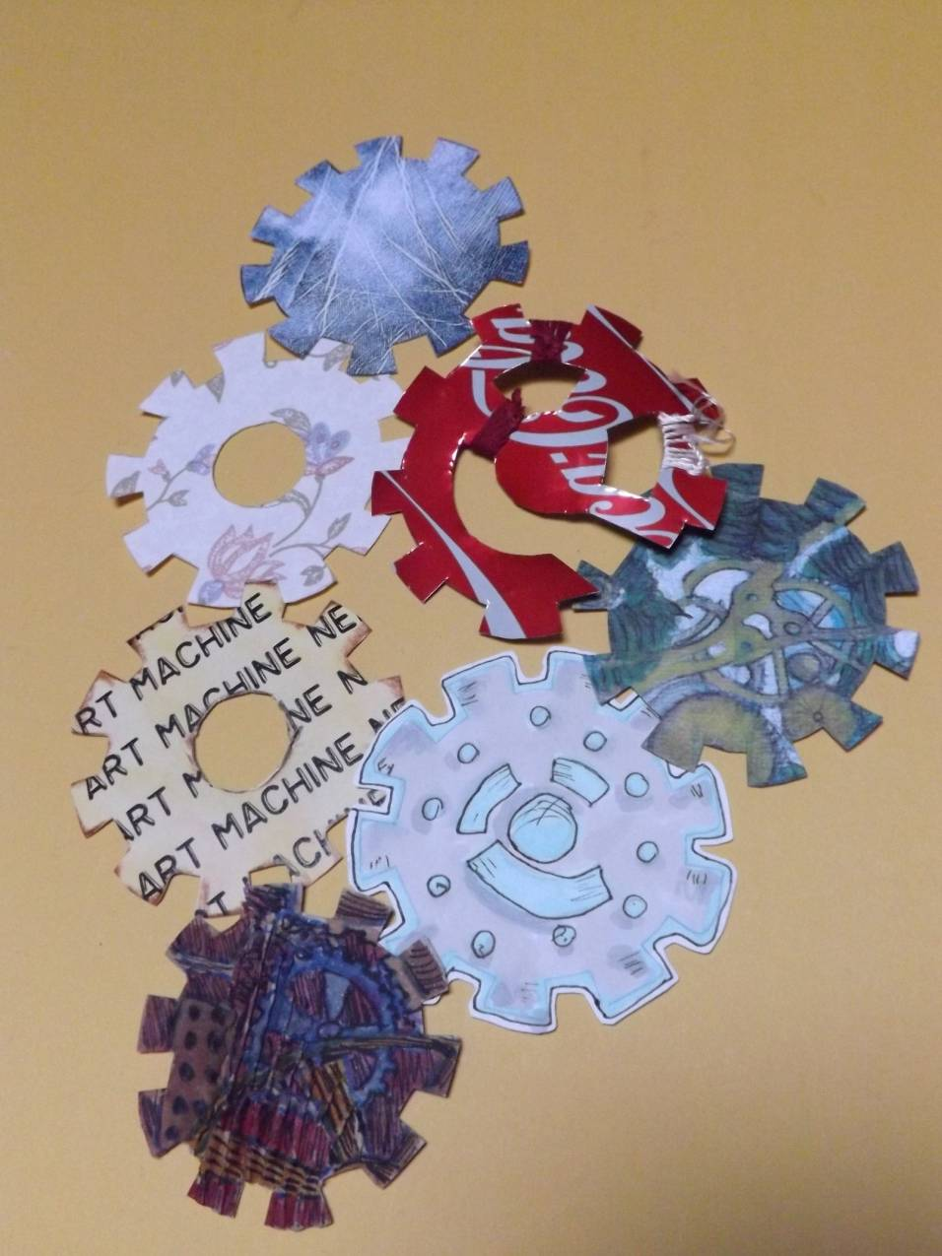
The Cogs Project
In the cogs project, you add your cog and send it on and also choose a name to send a random drawn postcard to.

Slide 21
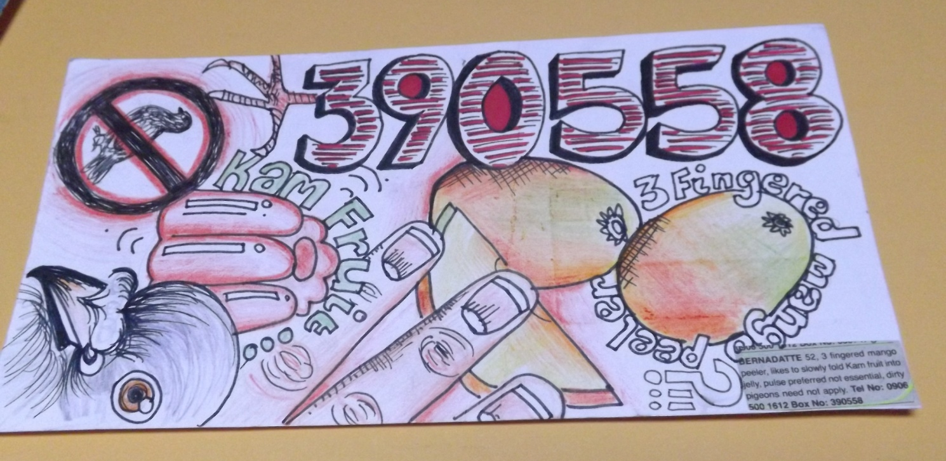
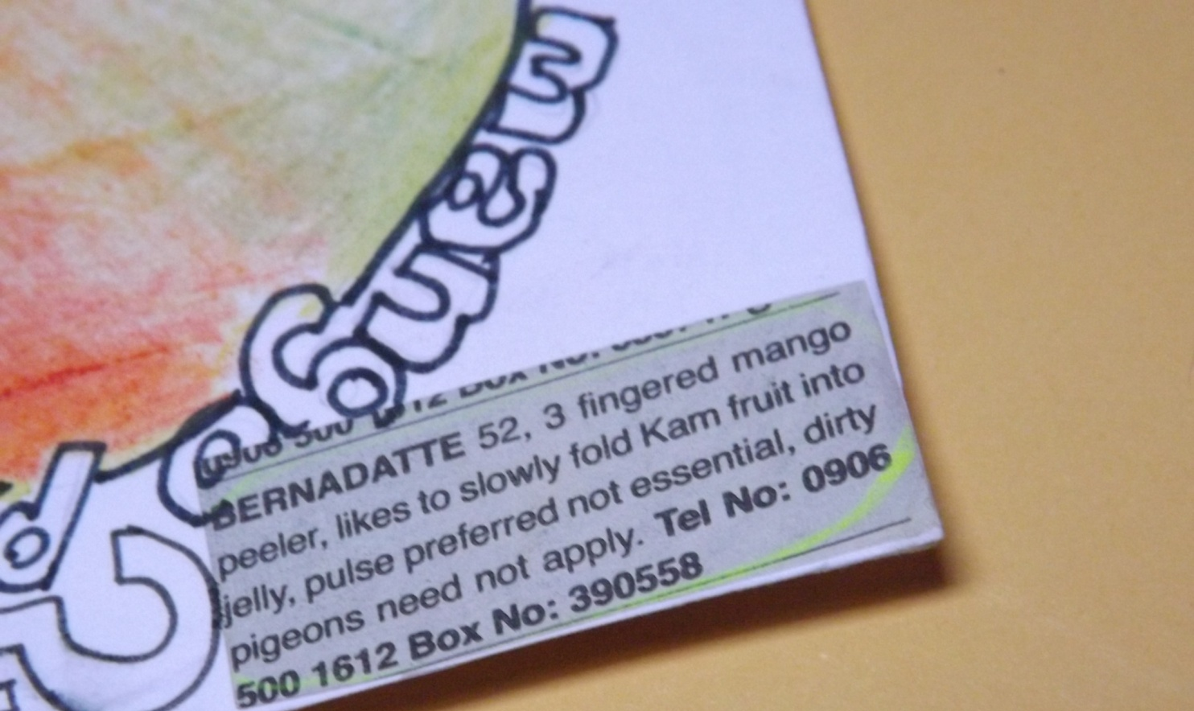
The Lonely Hearts Project
In the Lonely Hearts Project you responded to
an advert with your own illustration.

Slide 22
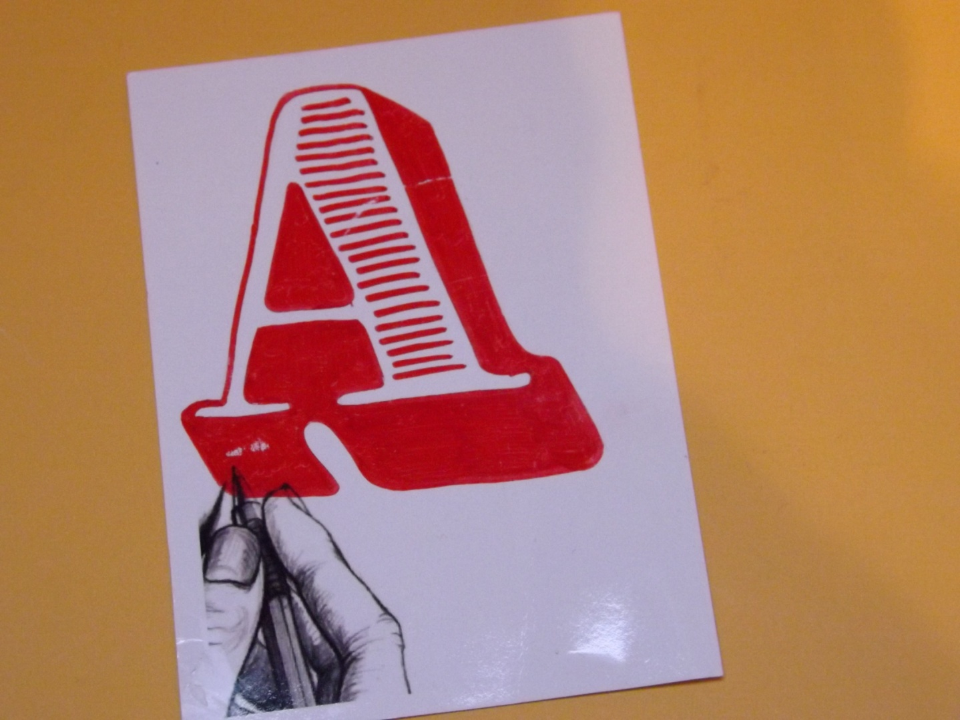
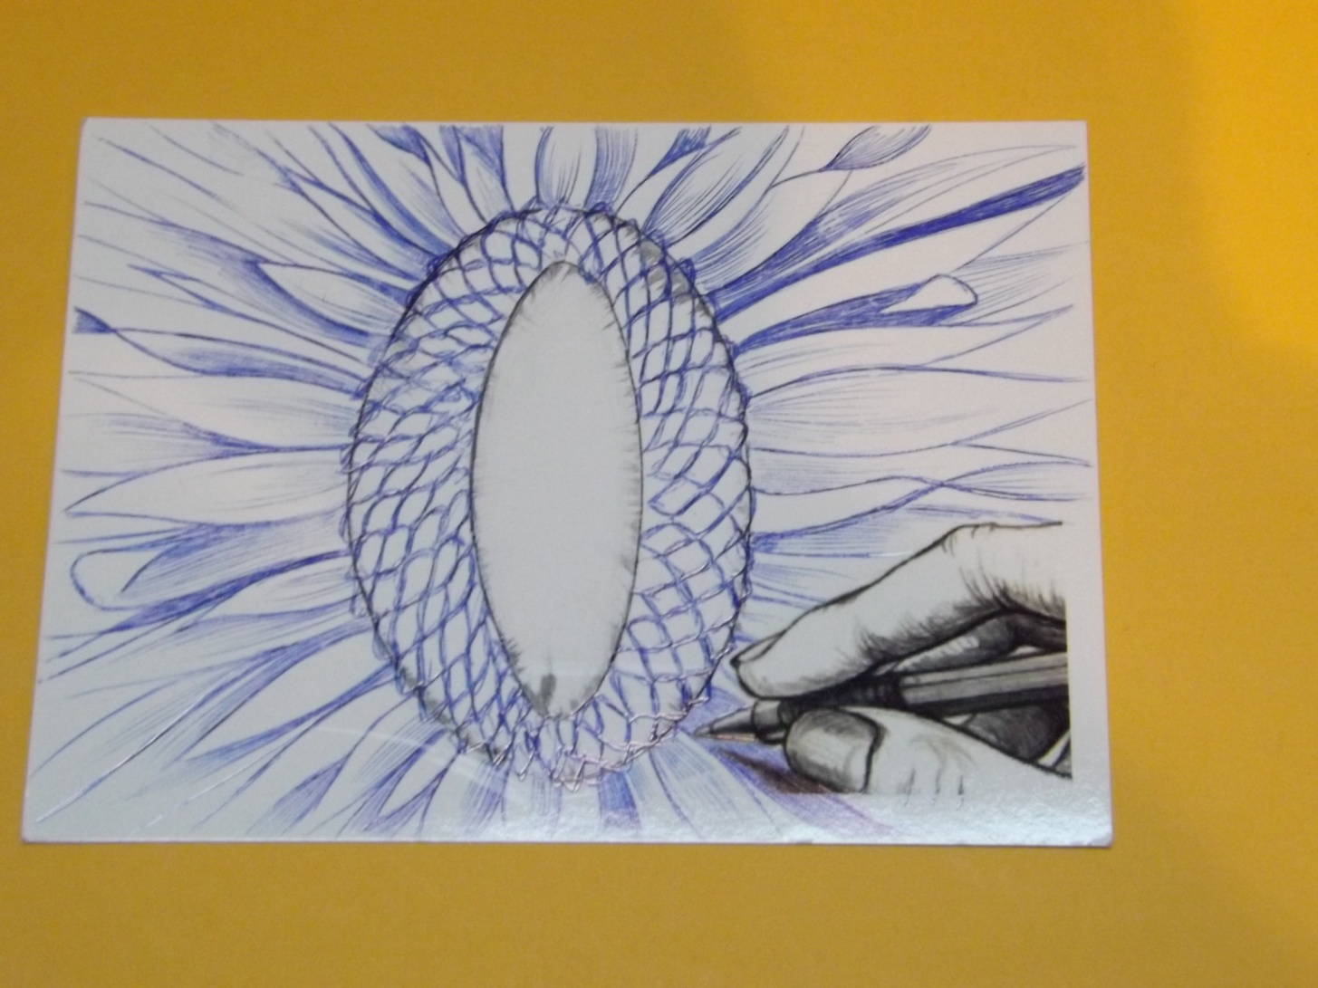
The Typography Project
The Typography project invited everyone to create a letter to make up the word “Collaborate”.

Slide 23
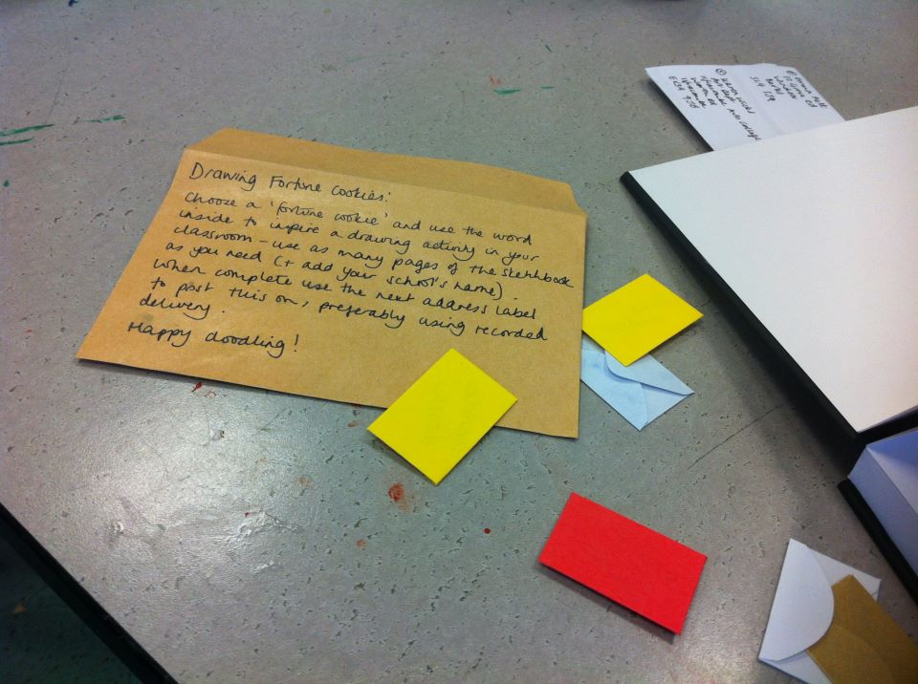
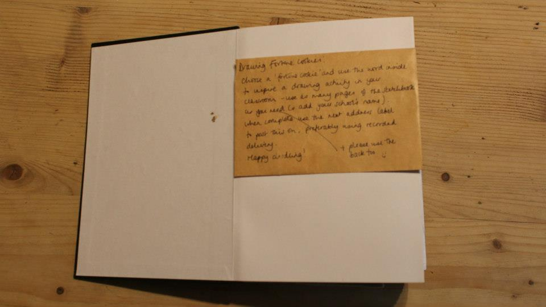
The Travelling
Sketchbook Project
These sketchbooks are still travelling from school to school, with
learners responding to drawings created by others in different schools.

Slide 24
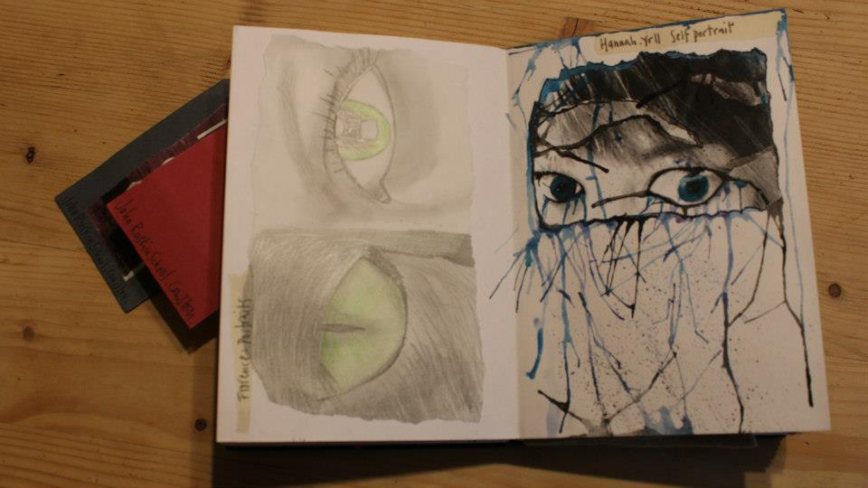
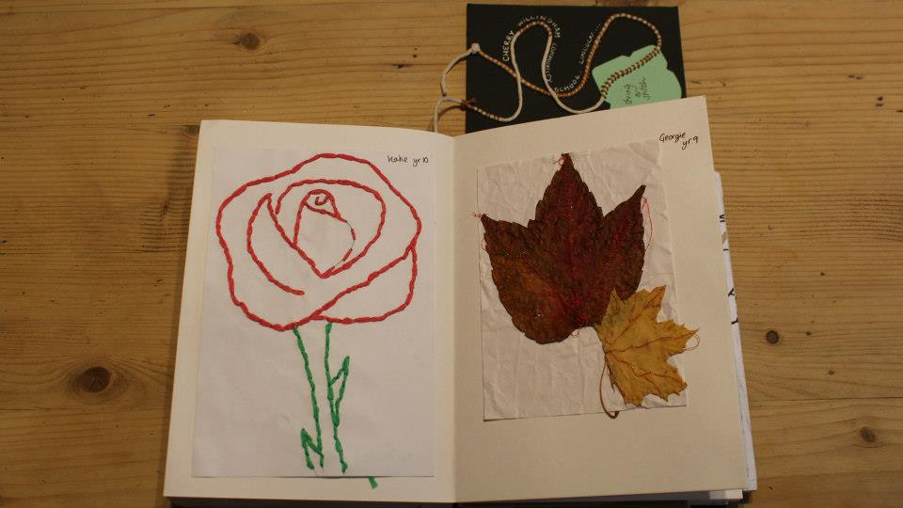
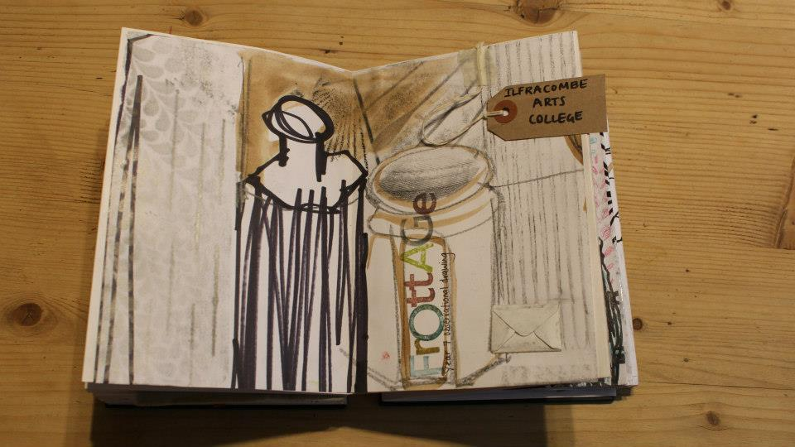
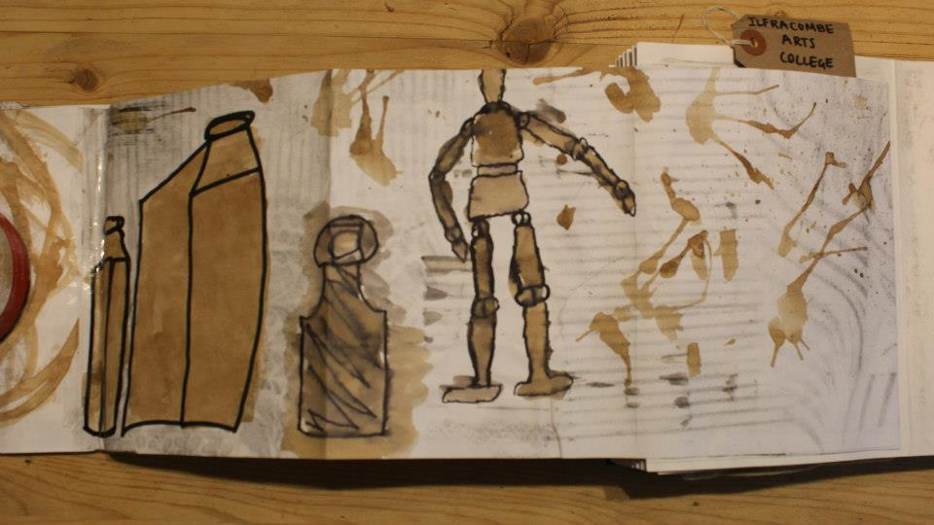

Slide 25
http://www.youtube.com/watch?v=YCbtH--lcJU

Slide 26
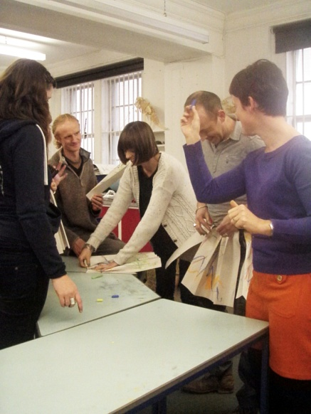
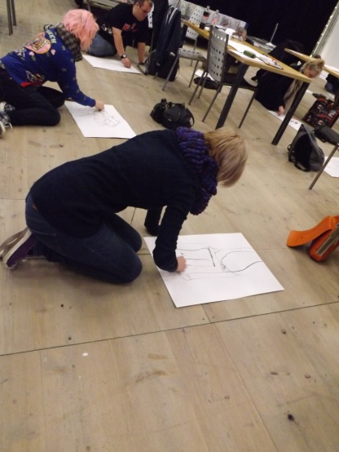
Face to Face Days
Great to see people meeting face to face who had already met online.
Facebook page very active after the face to face days.

Slide 27
The Christmas Card
At the “face to face “ days, everyone got a blank envelope to draw on and write their address on. These were exchanged at the end of the day. They were invited to draw a Christmas card for the person whose envelope you had. This was the first whole group collaboration. This will be repeated at the TEA National Symposium.

Slide 28
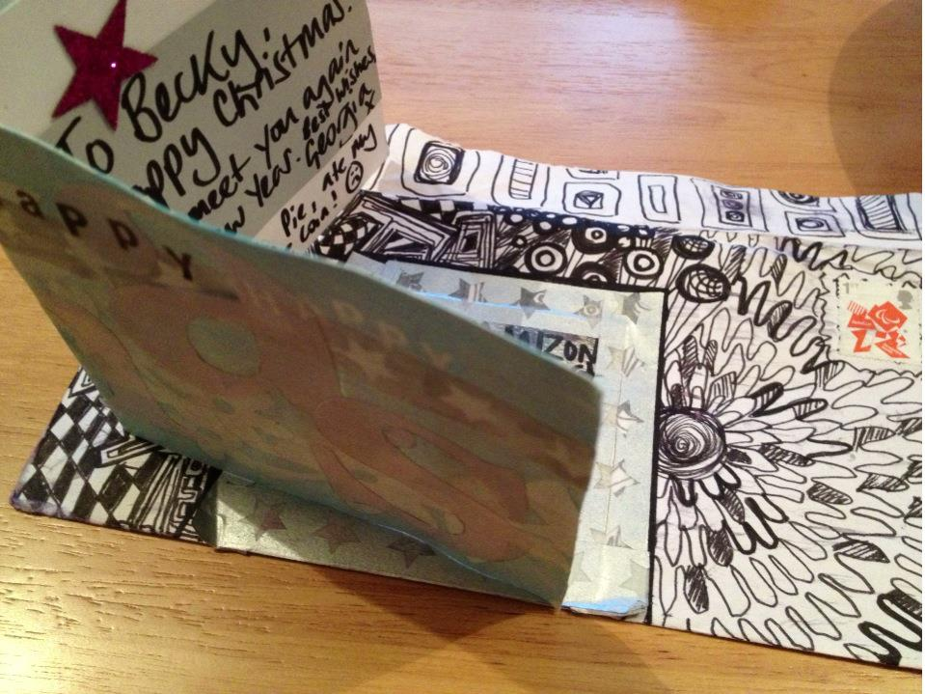
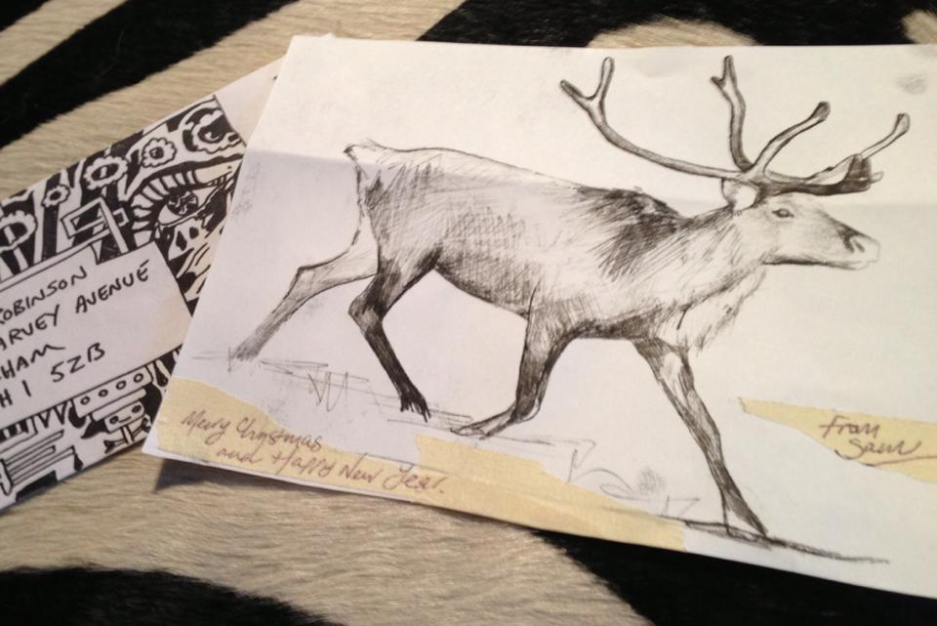
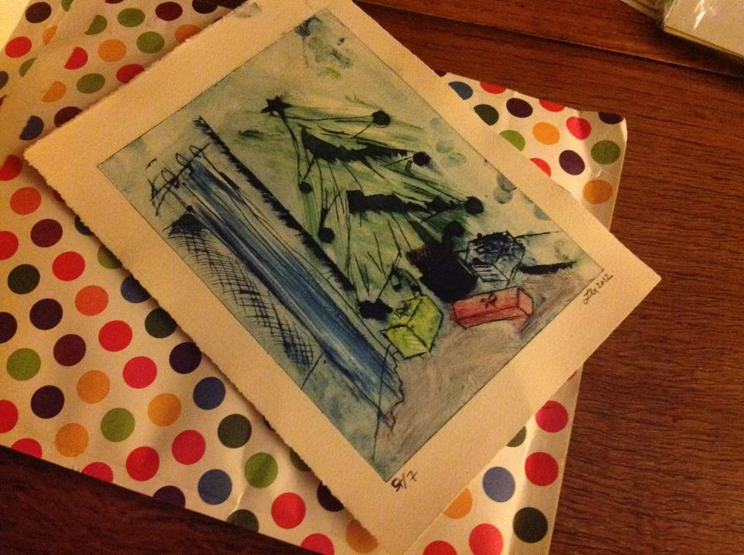
The Christmas Card

Slide 29
2012 to 2013... and onwards
Collaborative work with learners in different schools also started.....

Slide 30
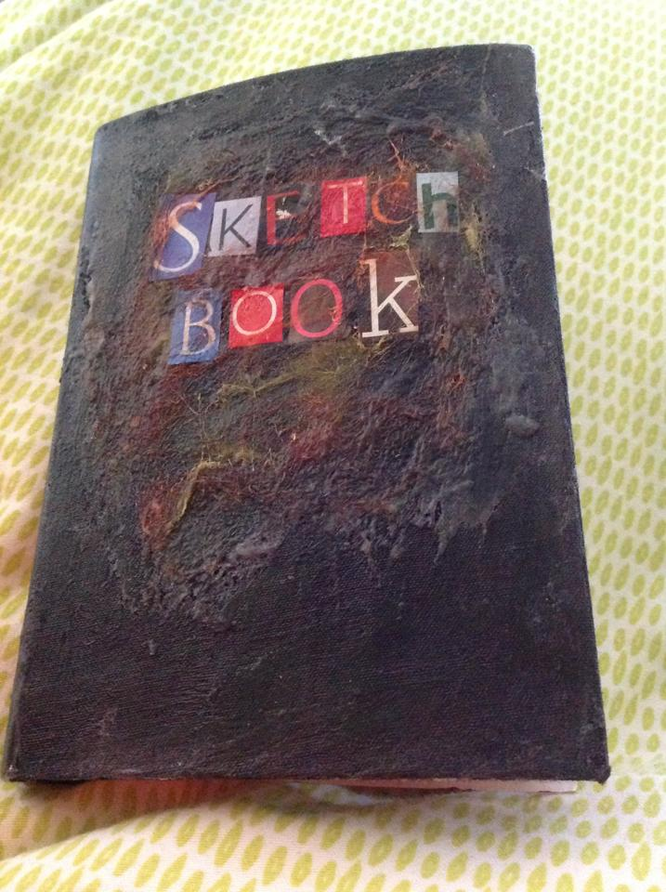
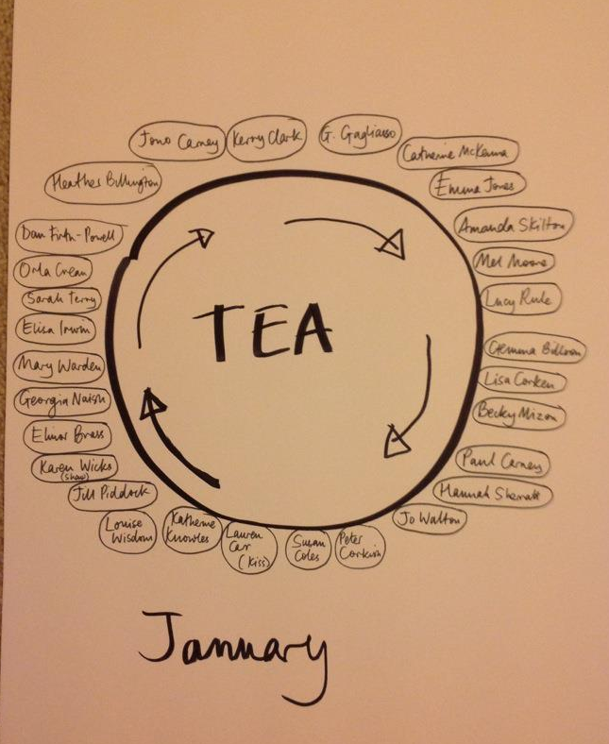
2012 to 2013... and onwards
Sketchbook Circle, idea from Elinor Brass.
25 teachers (some from outside of TEA group)

Slide 31
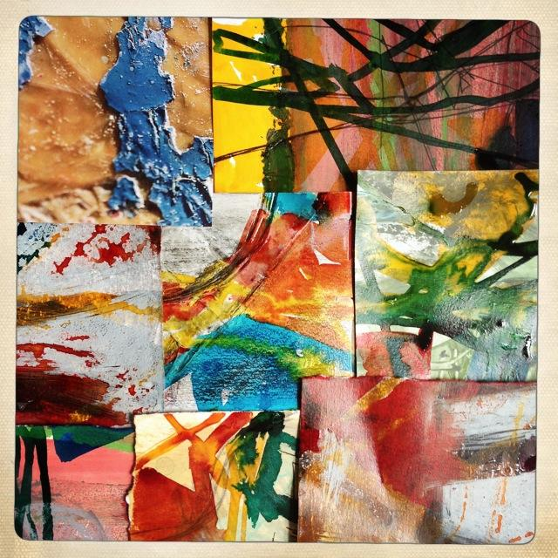
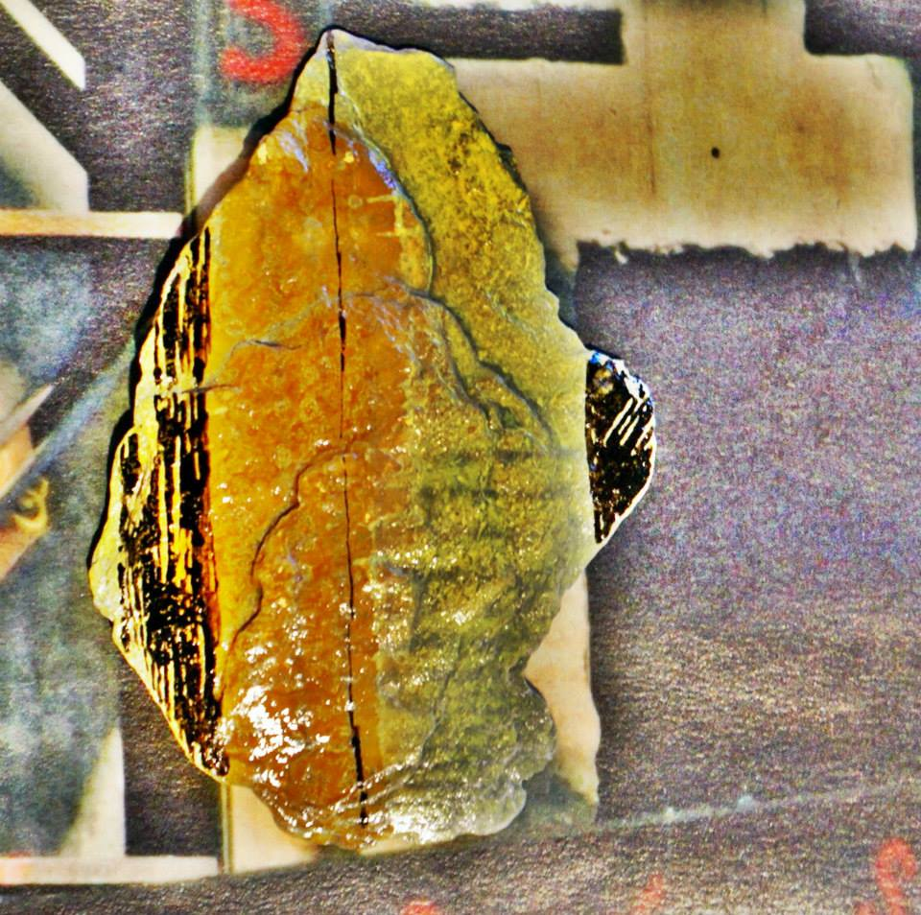
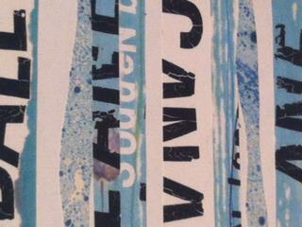
A circle of 25 teachers began to exchange sketchbooks every month, staring in January 2013.
This project is ongoing.
Susan Coles and Elinor Brass will deliver a paper about this at the 2013 International Journal of Art Education Conference.

Slide 32
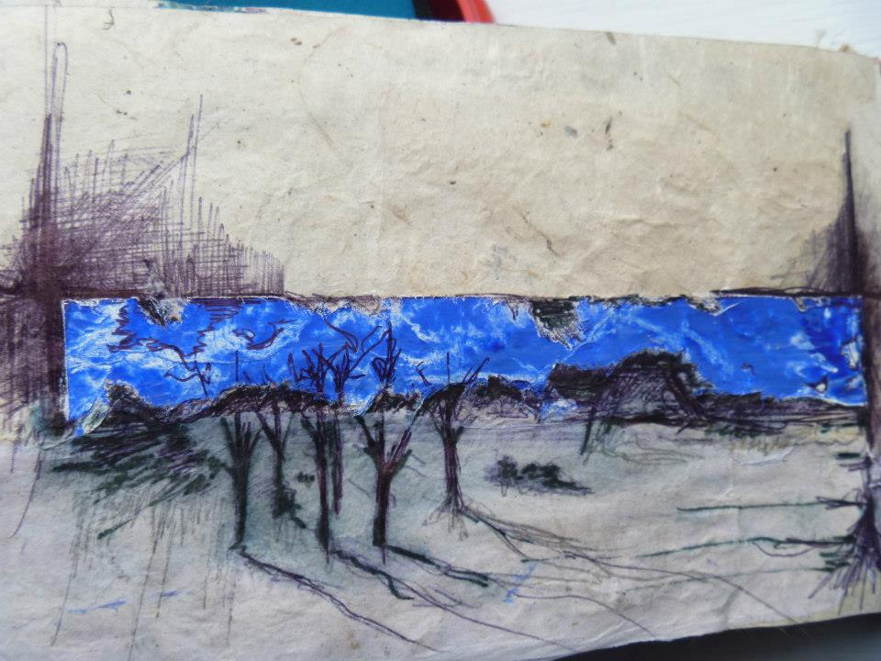
There are now other sketchbook circles, for example, being used in schools with learners, the North East art teacher network working with the Yorkshire Art Teacher Network.

Slide 33
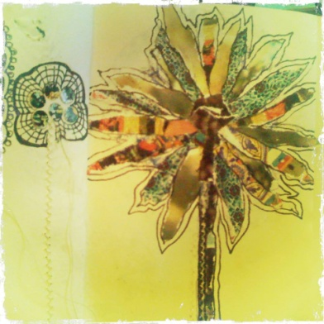
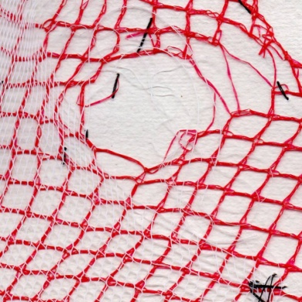
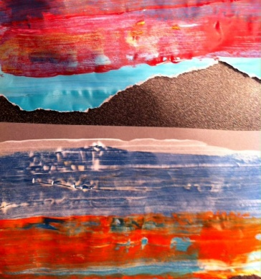
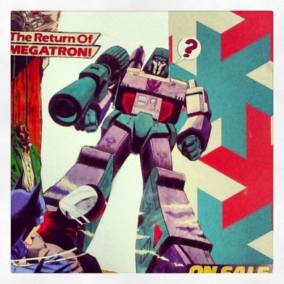
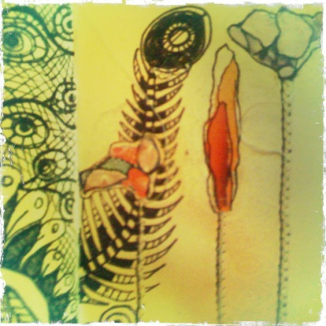
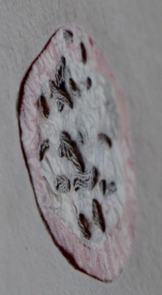
Articles on Sketchbook Circle
http://www.wellingvisualarts.org/making-time-for-making-art-susan-coles.html
https://www.edexcel.com/subjects/Art-Design/Pages/ViewEditorial.aspx?editorial=832
http://www.artcrimes.org.uk/blog/107/sketchbook-circle-and-teabag-art-and-a-national-tea-day

Slide 34
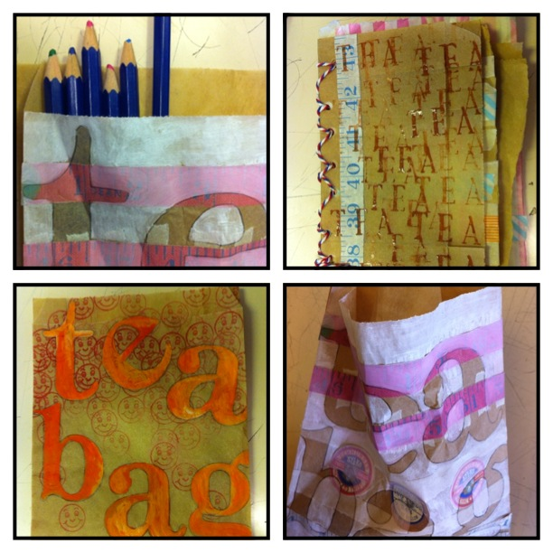
The TeaBAG project
Organised by Georgia Naish. Each participant received a small pack of paper bags and was asked to send these bag once they had finished making art with them. This is an ongoing project and Georgia is creating a resource pack developed from them to use as part of a scheme of work. This will be distributed to those who took part.

Slide 36
National Tea Day July 2013
http://thinkingexpressionaction.weebly.com/what-is-it.html
Introduced at the NSEAD National Conference, and steered with great skill by Karen Wicks, National TEA Day had requests from over 100 schools to take part. Teachers were encouraged to use an online blog to record their activities.
Primary schools also responded: http://kirkleesarts4all.blogspot.it/2013/06/first-day-of-tea-thinking-expression.html
Even Yorkshire Tea blogged about it!

Slide 37
National Tea Day July 2013
http://thinkingexpressionaction.weebly.com/what-is-it.html

Slide 38
National Tea Day July 2013

Slide 39
Conferences, articles etc on social media projects...
TEA was a topic in AD magazine. Will feature in September edition too.
TEA was a topic on the Edexcel/Pearson web page
TEA was a presentation at the ‘engage’ Midlands meeting
TEA was presented at local art teacher networks, from Kent to Gateshead, by TEA participants
TEA was a presentation at NSEAD National Conference March 2013 (Oxford)
TEA was a mini presentation at INSEA European Congress and delegates took part in an envelope drawing project
TEA will be presented as a project at the INSEA World Conference July 2014 (Melbourne)
TEA was tweeted, talked about, blogged about.
TEA has invited comments and enquiries from Australia to South America
TEA Facebook activities have grown to include other individuals and other groups.....

Slide 40
Summer project 2013
Due to huge interest outside of the original group, we launched a bigger project this summer, organised by Karen Shaw and Georgia Naish.

Slide 41
85 people signed up

Slide 43
TEA has a flickr page which contains many of the images
teacpd flickr page
http://www.flickr.com/
At the end of August the page had hosted over 39,000 “hits”.

Slide 44
Social media and TEA
Social media has been the glue in this whole project and will continue to be so.
It has shown that there are alternatives to having professional development opportunities and using these effectively for that.

Slide 45
Some feedback....
“By posting and seeing other Tea work, it has directly impacted in my own lessons.”
“Also by using the tea Facebook site as evidence of critical feedback we now have own school twitter site where learners work is celebrated and tweeted for peer and self assessment.”
“The sketchbook circle project, although very much in its infancy, has been enormously exciting, challenging, inspiring and down right scary at times!”
“The various collaborative projects have also given me a wealth of ideas to try with my students , it is clear how beneficial these projects can be for the young people.”
“It would be true to say that TEA has completely changed my career direction as I am renewed, re-invigorated and excited.”

Slide 46
Some feedback....
“Collaboration as art educators has facilitated new ideas for me, both in my own work and with pupils. Using the FB page has become a regular source of support and inspiration.”
“The opportunities with social media have made it so easy to share ideas and experiments and to get instant feedback. Getting to know lots of other people has been brilliant. I think Art teaching is an amazing profession and it is wonderful to meet other passionate people.”
“Facebook has been the main way this support has worked for me. Instant feedback, huge amounts of visual inspiration. Helpful network of supportive teachers.”
“I have loved being part of the group projects as it's great to send off a small part and then see the work produced as a whole!”

Slide 47
Some feedback....
“The brilliant thing about FB is its immediate and can be added to at any time and plenty of people are happy to share ideas, thoughts and opinions etc.”
“Consequently I really have TEA and the TEA experience to thank for that....... So a HUGE THANKS to everyone on here for their inspiring work and constant sharing as during some pretty dark moments I always knew my Art department was doing the right thing because I only had to look at Facebook for support. TEA is incredibly empowering.”
“I go home at night and I’m tired, really tired. I open up the TEA Facebook page and feel as if I am in a virtual room full of like minded people. You have all taught me so much.”

Slide 48
Some updates....
The first Sketchbook Circle exhibition was held at the Gerald Moore Gallery in London in February 2014.

Slide 49
Some updates....
Sketchbook Circle 2014 has begun
TEAEnvelope Swop has begun
TEADigital swop has begun.

Slide 50
How to keep up to date with TEA
Join the moreTEA Facebook page
Join the TEA Sketchbook Circle Facevbook page
Visit the moreTEA blog http://kashaw2.wix.com/moretea
Email me at susanmcoles@gmail.com

Slide 51
TEA Thinking, Expression, Action
The social media story

