Slide 1

ITT Market Review
Dr Emese Hall, Graduate School of Education, University of Exeter
NSEAD Vice President

Slide 2
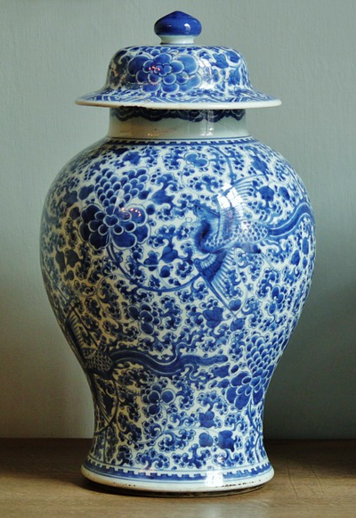



kintsugi

Slide 3

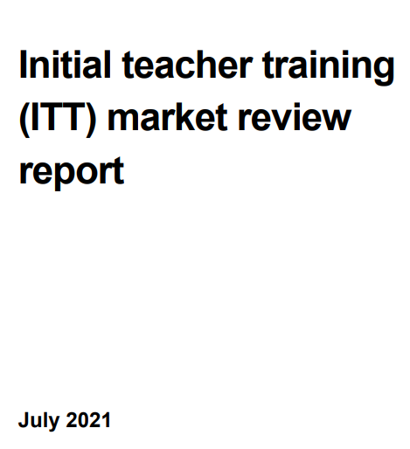

ITT review aims
The review has considered how the ITT sector can provide consistently high-quality training, in line with the core content framework, in a more efficient and effective market.
The review has aimed to make well informed, evidence-based recommendations on how to make sure:
all trainees receive high-quality training
the ITT market maintains the capacity to deliver enough trainees and is accessible to candidates
the ITT system benefits all schools

Slide 4
Schools Week article 05 July 2021
DfE wants ALL providers to apply for reaccreditation
Ministers to broker trainee transfer of failing providers
ITT ‘expectation’ for growing academy trusts
Evidence-based training curriculum for all
New ‘intensive’ placements and minimum course duration
Requirement to find sufficient mentors
And providers must develop their own quality assurance
Ofsted set for expanded ITT role
Teaching schools hubs to buddy up with provider LINK

Slide 5
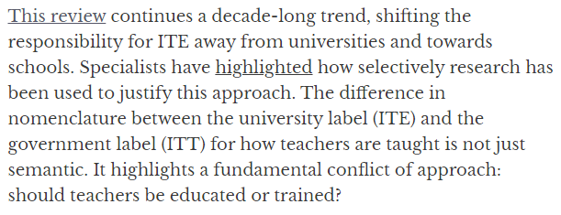
Clarke & Parker (2021) The Conversation article

Slide 6
Chartered College of Teaching: Response Summary
The timing of and rationale for this review are premature. The ECF needs to be fully embedded. The experience of the CCF needs to be fully
embedded. Where gaps emerge or where nuance needs to inform the ITT
curriculum and the ECF curriculum, time to reflect will be helpful. A review of the number of ITT providers could be reviewed to ensure local partnerships, thereby simplifying the application process. Mass re-accreditation will be costly and could result in the loss of some high-quality providers from the system. A rushed consultation process is unwise and unhelpful and risks significant disruption to a sector that is currently meeting the requirements of trainees, school partnerships and national priorities admirably. LINK

Slide 7


LINK

Slide 8
NSEAD Consultation Response LINK
‘‘We are unconvinced that these proposals, including the CCF, acknowledge the complexity and richness of teaching and learning in art, craft, and design. Generic training is no substitute for subject expertise, either for trainees or mentors.’’
‘‘The autonomy of subject experts in high-functioning ITE providers should be enabled with regards rationales and process of ITE in art, craft and design.’’

Slide 9
We strongly disagree with the proposal that providers should design and deliver an intensive placement experience of at least 4 weeks (20 days) for single-year courses and 6 weeks (30 days) for undergraduate course. This is particularly problematic for primary when so many different curriculum areas need to be addressed in the classroom. Does this meant that the focus will become narrowed even further than it is now?
‘‘NSEAD supports a focus on subject speciality. We believe that the logistical and geographical challenges of intensive placements will compromise any drive towards programmes being designed around subject and phase specific training opportunities.’’

Slide 10
‘‘As a subject association focused on art, craft and design education, we are concerned at a lack of awareness of the diversity of pedagogy that exists depending on a subject area or a particular curriculum, particularly in secondary education. We would like to see art, craft and design lead mentors but do hold concerns related to resources, time and money to facilitate this.’’
In principle, we agree with the proposal that providers offer suitable mentor training. However, we are concerned that generic mentor training is insufficient to support trainee art, craft and design teachers. If subject-specific training is to be provided, who will offer this?

Slide 11



Slide 12


