Slide 1
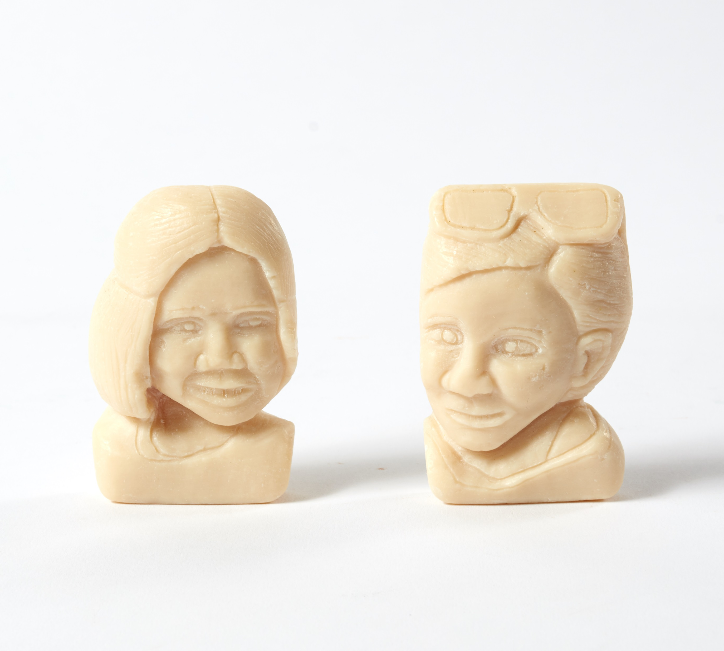


Sally Taylor
Chief Executive
Brave Face
HM Prison & Young Offender Institution Exeter
Commended Award for Sculpture

Slide 2
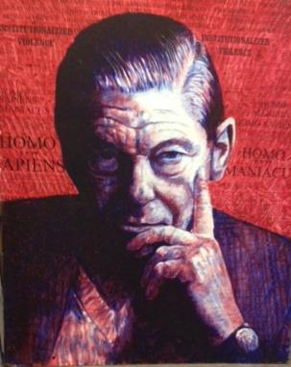

Arthur Koestler (1905 – 1983)
20th Century writer, journalist and thinker
Spent time in prison in
Spain, France and England
Most famous book, Darkness
at Noon, based on his time in prison.

Slide 3
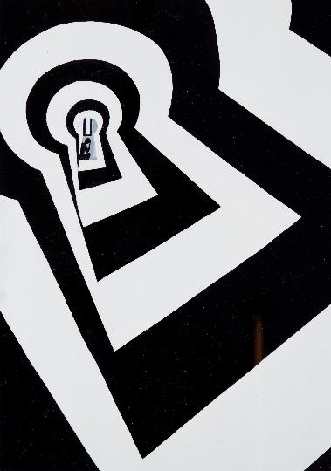
Charity’s Aims
- Help prisoners, secure patients and detainees lead more positive lives by motivating them to participate and achieve in the arts
- Increase public awareness and understanding of arts in the criminal justice system
- Be a dynamic, responsive organisation which achieves excellent quality and value for money
Mona-Keys
HM Prison Whatton
Drawing

Slide 4
Our Activities
Sales
Exhibitions
Outreach and Involvement
Awards
Events
Mentoring

Slide 5
2020 Awards
In 2020 we received 6,550 entries from 3,033 entrants and a total of 2,596 awards were given out
52 artforms including Poem, Stage Play, Spoken Word, Hip Hop, Rap and Grime, Choral Music, Film, Painting, Drawing, Sculpture, Furniture, Matchstick Model, Needlecraft
Themed category for 2020: Window
276 establishments – prisons, probation, youth offending teams, secure hospitals, children's homes and immigration removal centres across the UK enter the Awards, as well as British prisoners serving sentences abroad
Certificate for every entrant and feedback to as many people as possible (75%)
£30,000 in prize money – ranging from £20 for a Bronze Award to £100 for a Platinum Award

Slide 6
52 Artform Categories:
Writing:
Flash Fiction and Short Story
Longer Fiction and Novel
Non-Fiction, Blog, Essay, Article and Review
Life Story
Braille
Poem
Poetry Collection
Anthology
Stage Play
Radio Play
Screenplay
Song Writing
Fine Art:
Painting
Watercolour and Gouache
Drawing
Sculpture
Ceramics
Mixed Media
Pastel
Portrait
Photography
Textile Art
Digital Art
Graphic Novel
Mural and Wall Hanging
Printmaking
Project Work:
Art Project
Performance and Audio:
Spoken Word
Radio Production
Performance
Music Composition
Choral Music
Instrumental
Cover Version
Hip Hop, Rap and Grime
Computer Generated Music
Singer-Songwriter – Original
Craft and Design:
Needlecraft
Woodcraft
Furniture
Matchstick Model
Handmade Book
Handmade Greetings Card
Beauty
Hairstyling
Fashion
Graphic Design
Craft
Calligraphy
Film and Animation:
Film
Animation
Themed Category:
Window

Slide 7
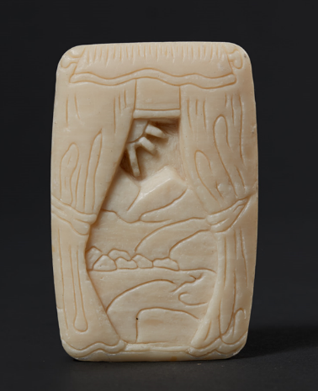
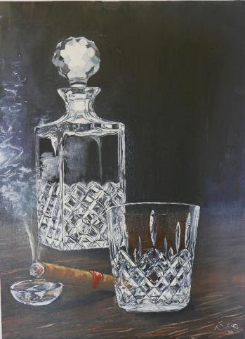
Themed Category: Window
‘I do small carvings into soap bars anyway and I thought of doing one for Koestler Arts and keeping to this year’s theme ‘Window’ – that’s how your little piece Clean View came about. I was thinking about the window theme and what I could do with it, then I also thought about growing up in the countryside and the landscapes around me that I loved so much.’
Artist Comment
Clean View
HM Prison Peterborough
Themed Category: Window
Exhibited Artwork
Windows of Destruction
HM Prison Buckley Hall
Silver Award for Themed Category: Window

Slide 8
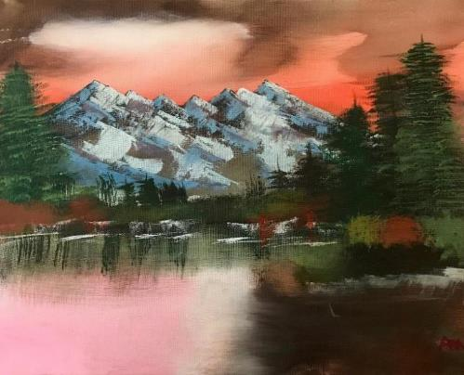
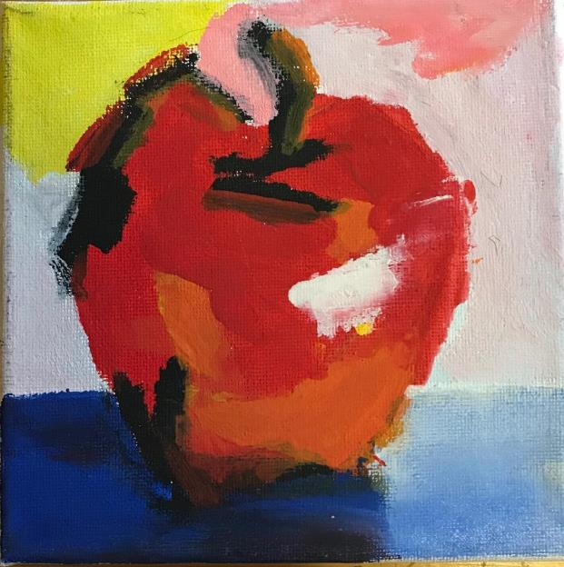
Painting
Japanese Mountains
Cheshire East Youth Offending Service
Commended Award and Under 18s Special Award for Painting
Apple for Eve!
HM Young Offender Institution Cookham Wood
Platinum Award and Under 18s Special Award for Painting

Slide 9
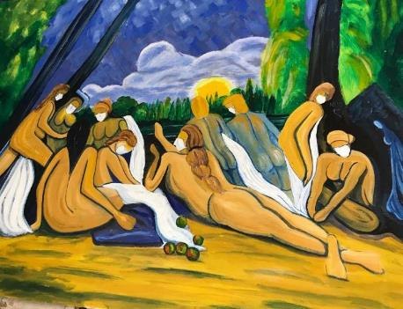

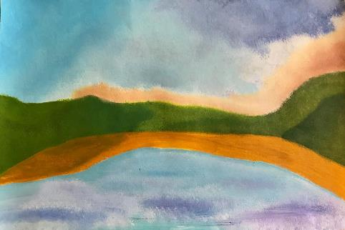
Lockdown Cezanne
HM Prison Grendon
Painting
Nearly Went in the Bin
HM Prison Lewes
First-Time Entrant Award for Painting
Protect It Now
HM Prison Humber
Bronze Award for Painting

Slide 10
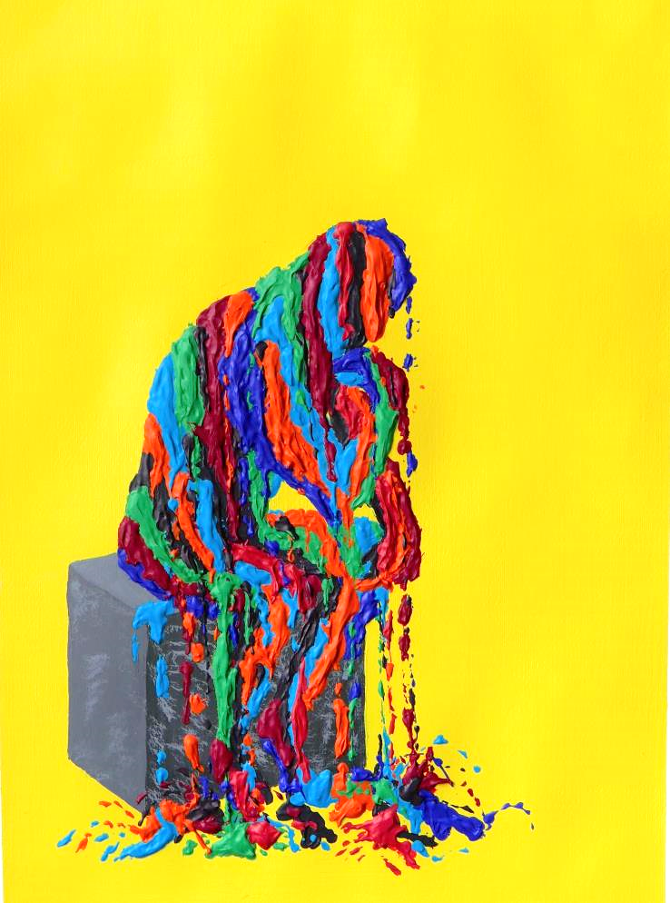
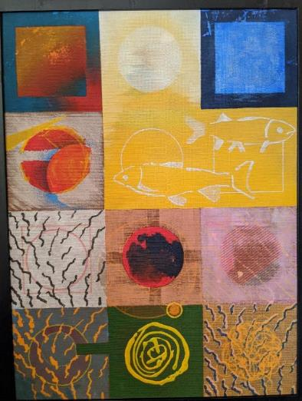
‘Being creative is a great outlet for me to express myself as I am not great at vocalising or using conversation.’
Artist Comment
Meltdown
HM Prison Long Lartin
Platinum Award for Painting
Circle Squares
HM Prison Peterborough
First-Time Entrant Award for Painting

Slide 11
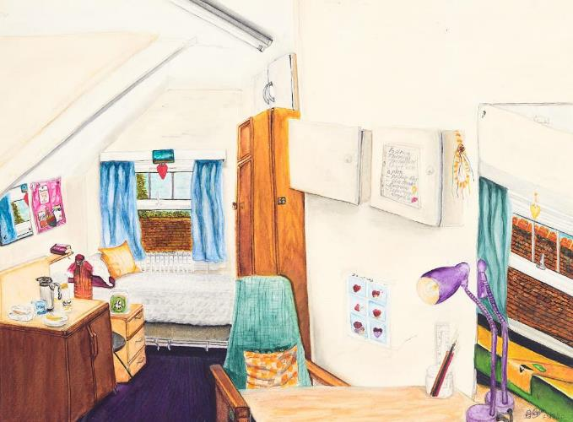
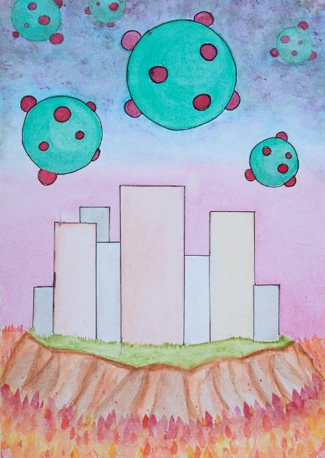
Watercolour & Gouache
Serenity Room H301
HM Prison & Young Offender Institution Askham Grange
Bronze Award for Watercolour & Gouache
Virus
HM Prison & Young Offender Institution Parc
Bronze Award for Watercolour & Gouache
Exhibited Artwork

Slide 12
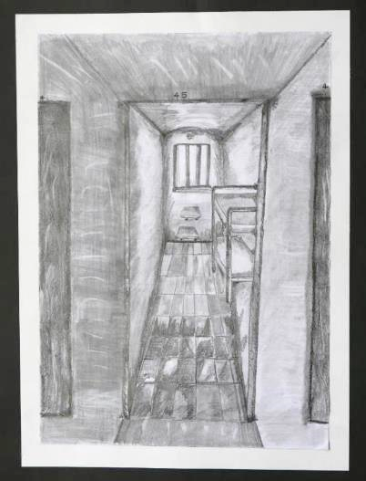
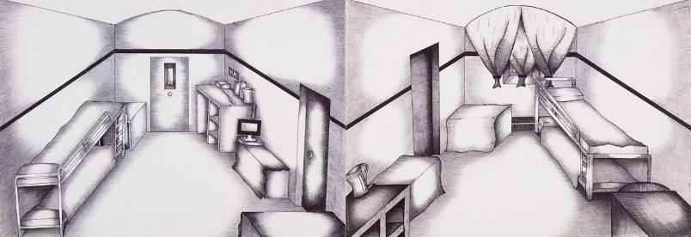
Drawing
Bare Cell
HM Prison Lewes
Bronze Award for Drawing
Exhibited Artwork
‘My drawing is a doodling and I only went to Art to get me out the cell… it was my Art Tutors that told me to do some work for the Koestler as they knew I’d do well in it and I’m shocked that over 6,500 entries and my work’s in the top 60!!’
Artist Comment
Looking Through An Open Door
HM Prison Kilmarnock
Gold Award for Drawing

Slide 13
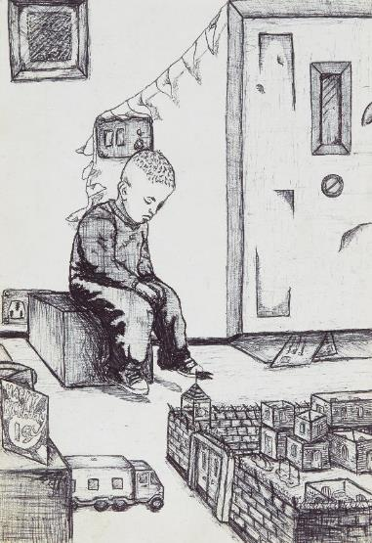
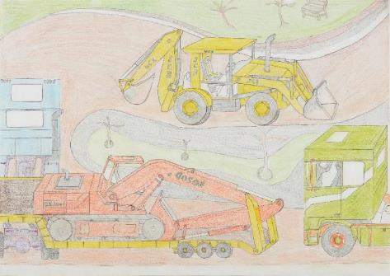
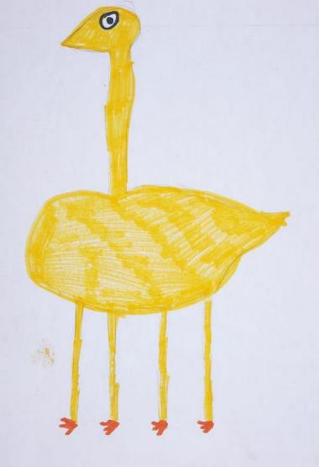
Machines At Work IV
HM Prison Huntercombe
Commended Award for Drawing
Birthday
HM Prison Lewes
Bronze Award for Drawing
Ducky
HM Prison Bronzefield
Drawing
Exhibited Artwork

Slide 14
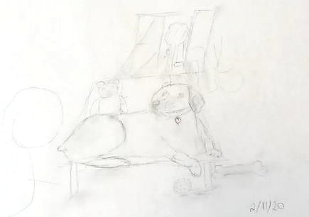
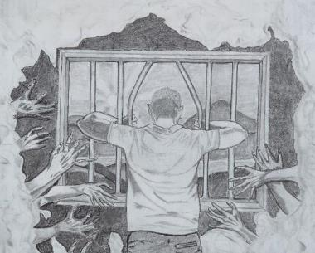
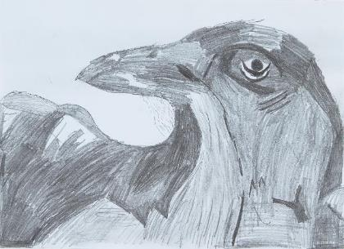
Masterpiece
Bridge House MSU, Lambeth Hospital
Drawing
Escaping the Demons
HM Prison Kilmarnock
Highly Commended Award for Drawing
Raven! Raven!
HM Young Offender Institution Cookham Wood
Highly Commended Award for Drawing

Slide 15
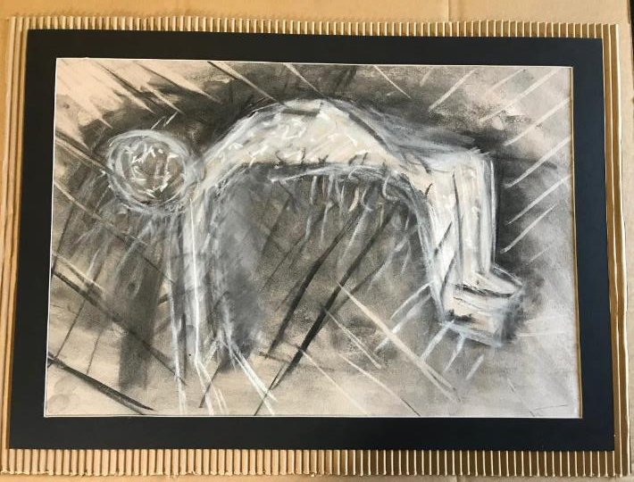
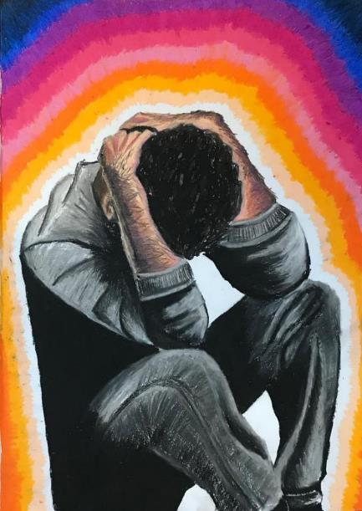
Pastel
Study 3 for “Rising Above”
HM Prison Glenochil
Silver Award for Pastel
ESP – Cerebro
HM Prison Belmarsh
Bronze Award for Pastel

Slide 16
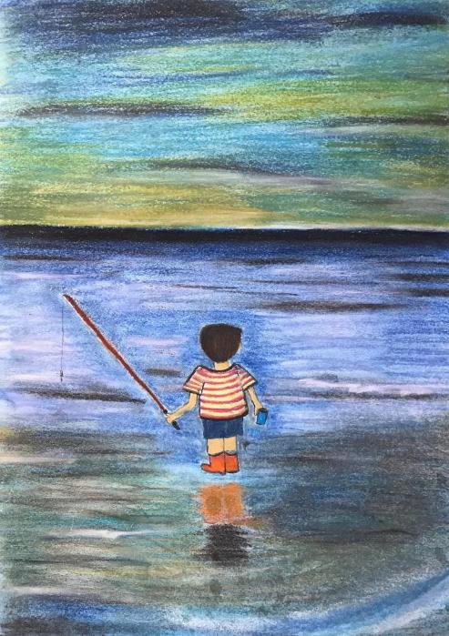
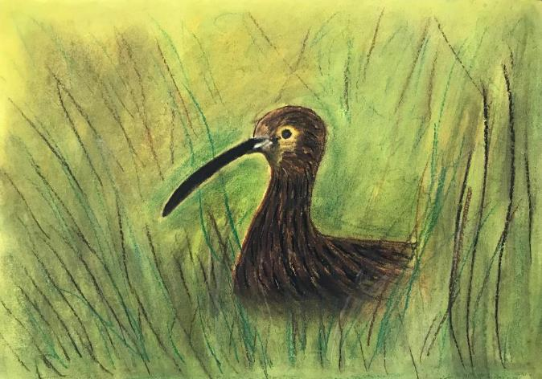
Lonely
HM Prison Huntercombe
Commended Award for Pastel
Good Days
HM Prison Huntercombe
Highly Commended Award for Pastel

Slide 17
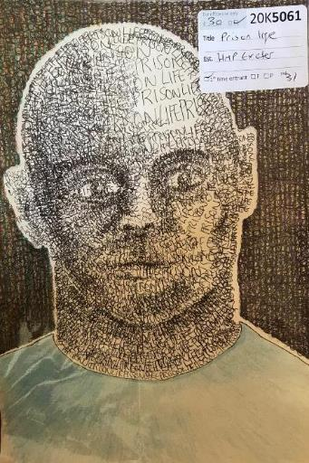
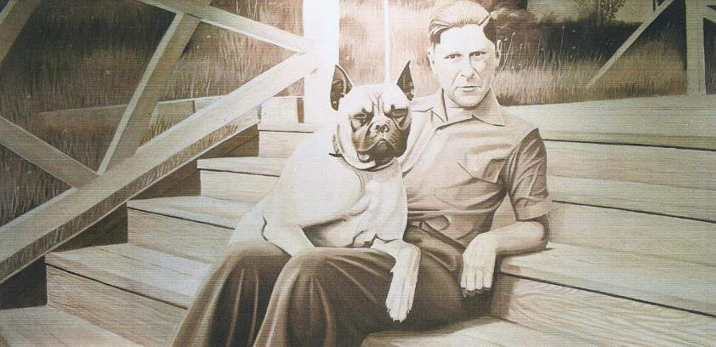
Portrait
Portrait of Arthur Koestler
HM Prison Humber
Bronze Award for Portrait
Prison Life
HM Prison Exeter
First-Time Entrant Award for Portrait

Slide 18
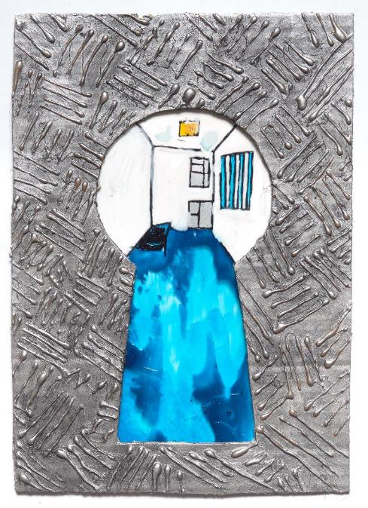
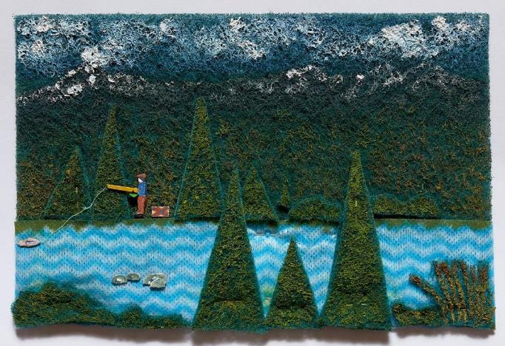
Gone Fishing
HM Prison Humber
Bronze Award for Mixed Media
Through the Keyhole
HM Prison Kilmarnock
Mixed Media
Exhibited Artwork
Mixed Media

Slide 19
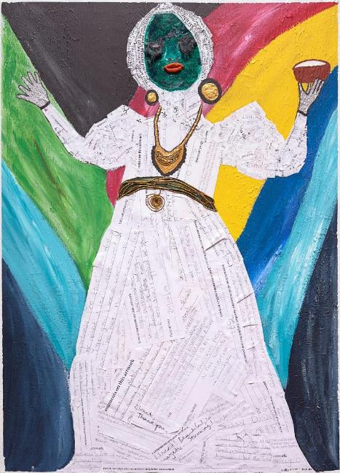
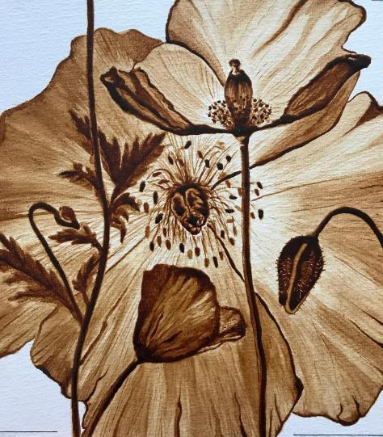
Miss Lou
HM Prison Long Lartin
Silver Award for Mixed Media
Exhibited Artwork
‘Being creative makes me feel good inside at all times and brings bright positives in my mind and mental health.’
Artist Comment
Portrait of a Flower
HM Prison Long Lartin
Commended Award for Mixed Media

Slide 20
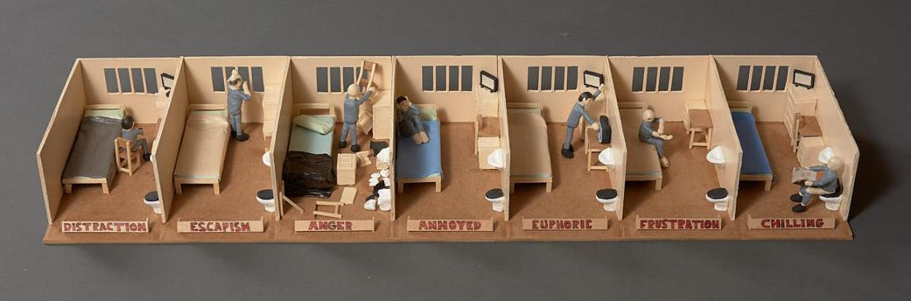
Sculpture
Several States of Mind
HM Prison Dartmoor
Silver Award for Sculpture
Exhibited Artwork
‘I have been in prison for 5 years now and seen the ups and downs with many people, just by talking to them has made me understand how difficult it can be in here so I wanted to make something that shows prison life.’
Artist Comment

Slide 21
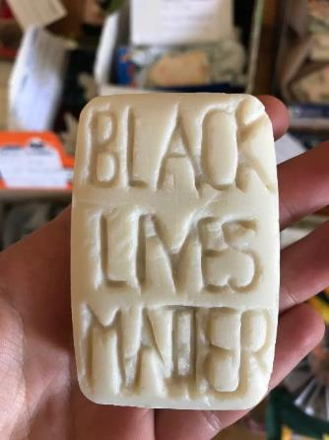
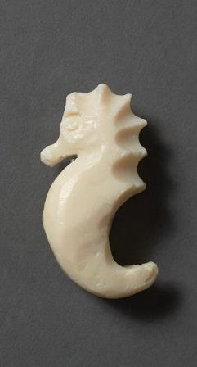
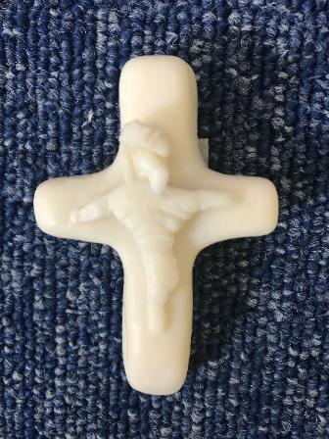
Keep Safe, Keep Clean I
HM Prison Bronzefield
Sculpture
Exhibited Artwork
Seahorse
HM Prison Bronzefield
Sculpture
Exhibited Artwork
God's Not Dead
HM Prison Bronzefield
Commended Award for Sculpture
Exhibited Artwork
‘your mind is free, no one can lock it up or down.’
Artist Comment

Slide 22
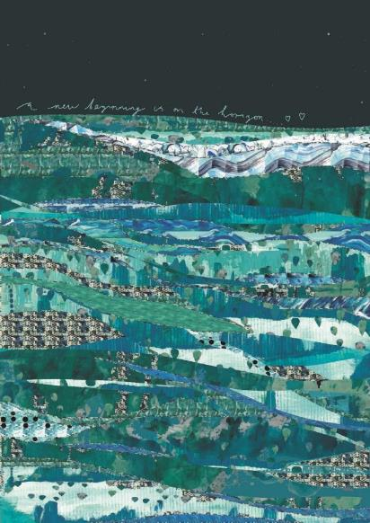
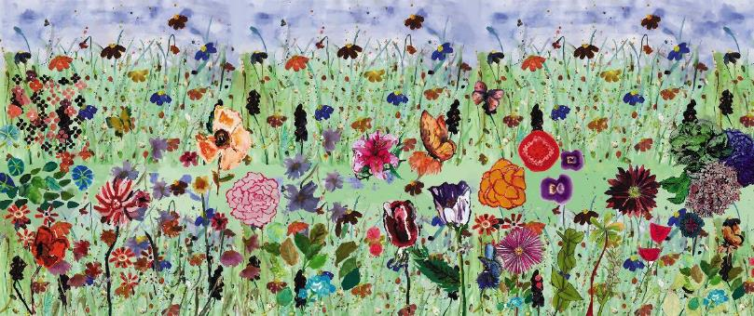
Digital Art
A Window into a Wild Meadow
HM Prison Holme House
Commended Award for Digital Art
The Horizon From My Cell Window
HM Prison Holme House
Highly Commended Award for Digital Art

Slide 23
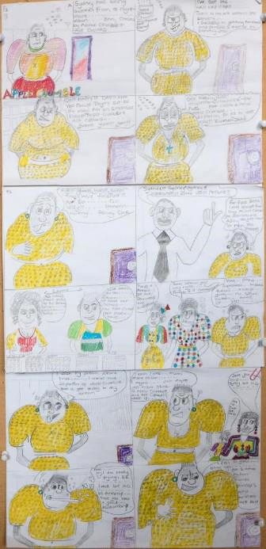
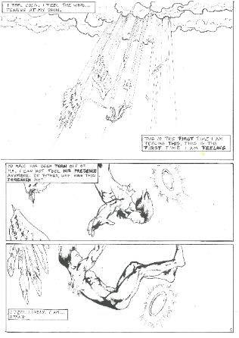
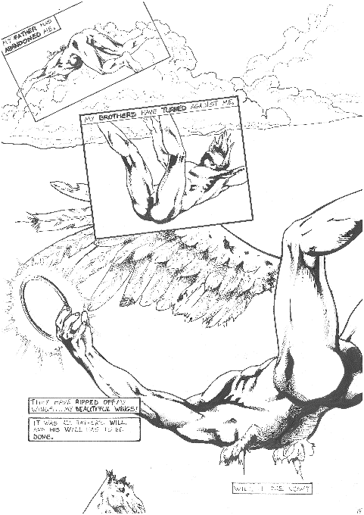
Graphic Novel
Resolution (detail)
HM Prison Bure
Gold Award for Graphic Novel
Apple Crumble
HM Prison Bronzefield
Platinum Award for Graphic Novel

Slide 24
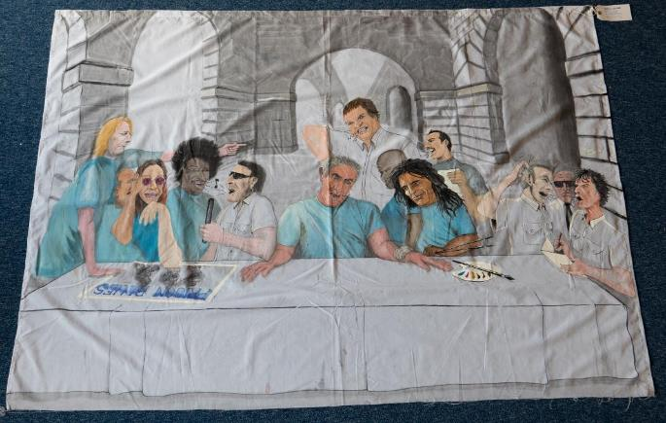
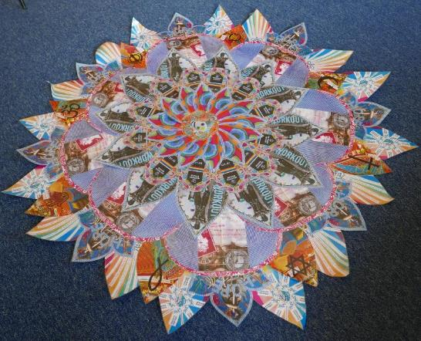
Mural & Wall Hanging
Last Rock Supper
HM Prison Ashfield
Gold Award for Mural & Wall Hanging
The ‘Nelson’ Mandala
HM Prison Isle of Wight (Albany)
Silver Award for Mural & Wall Hanging

Slide 25
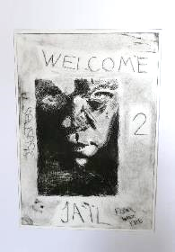
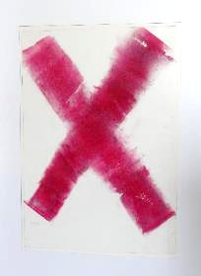
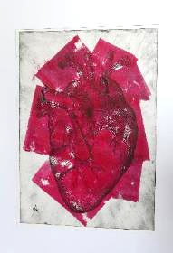
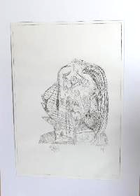
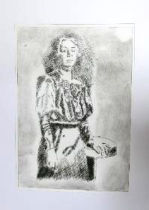
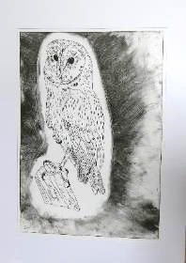
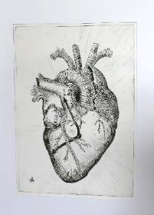
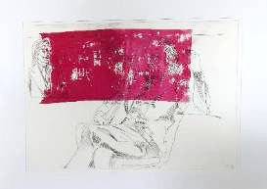


Art at HMP Grendon Prints
HM Prison Grendon
Platinum Award for Printmaking
Printmaking

Slide 26


Love Potion Pot
HM Prison Bronzefield
Bronze Award for Printmaking
The Silver Fox
HM Prison Exeter
Highly Commended Award for Printmaking
‘I chose to do a pot with a love heart on the front because I thought of my love for my family and that I have pot loads of love for them.’
Artist Comment

Slide 27



Climate Chain Cheese Greta
HM Prison Bristol
First-Time Entrant Award for Printmaking
The Last Tree
HM Prison Bristol
Commended Award for Printmaking

Slide 28



Photography
Diamond in the Sky
St Andrew’s Healthcare Northampton
Platinum Award for Photography
Lucky to be Alive (detail)
Langley Green Hospital
Bronze Award for Photography

Slide 29


Ceramics
Window of Opportunity
HM Prison & Young Offender Institution Parc
Platinum Award for Ceramics
Exhibited Artwork
Quirky Duck
HM Prison Dovegate
Under 25s Special Award for Ceramics
Exhibited Artwork

Slide 30


Textile Art
Hope
HM Prison & Young Offender Institution Low Newton
Bronze Award for Textile Art
Exhibited Artwork
Window Box
HM Prison Erlestoke
Platinum Award for Textile Art

Slide 31






Handmade Book
As I Was So I Shall Be
HM Prison and Young Offender Institution Parc
First-Time Entrant Award for Handmade Book
The Round Stuff
HM Prison Glenochil
Platinum Award for Handmade Book
Picasso in Prison
HMP Prison Lewes
Commended Award for Handmade Book

Slide 32



Calligraphy
Utopia 2
HM Prison Lewes
Commended Award for Calligraphy
Forgive Me
HM Prison Forest Bank
Commended Award for Calligraphy
Protect and Support
HM Prison Holme House
Highly Commended Award for Calligraphy

Slide 33



Handmade Greetings Card
Pug Card
HM Prison Northumberland
Gold Award for Handmade Greetings Card
Sea and Sky (Homage to Matisse)
HM Prison Thorn Cross
Platinum Award for Handmade Greetings Card

Slide 34





Window Boxes
Edenfield Centre, Prestwich Hospital
Handmade Greetings Card
Spiral
HM Prison Spring Hill
Handmade Greetings Card

Slide 35


Graphic Design
Hull Walk of Fame App Design (detail)
HM Prison Hull
Platinum Award for Graphic Design
Jail Break (detail)
HM Prison Magilligan
Bronze Award for Graphic Design

Slide 36


Matchstick Model
Galleon
HM Prison Northumberland
Platinum Award for Matchstick Model
Patience
HM Prison Dovegate
Gold Award for Matchstick Model

Slide 37


Craft
‘I liked making the parrots and then I thought it would be good to make them a cage to make them look like they were my pet birds and make my cell look nice, and it gets everyone talking about it all the time and that is good for my anxiety.
I think it [being creative] has changed my life and saved my life. I love being creative and showing off all my different artwork and I believe that when I do it other people get the joy out of it and that makes me so happy and I am part of the world again because people like what I am doing.’
Exhibited Artist Comments
Bird Cage - Imprisoned!
HM Prison Exeter
Gold Award for Craft
Exhibited Artwork

Slide 38



Rattus, Rattus
HM Prison Exeter
Craft
Exhibited Artwork

Slide 39



Woodcraft
Plane
HM Prison & Young Offender Institution Grampian
Bronze Award for Woodcraft
Backgammon Set
HM Prison La Moye
Commended Award for Woodcraft

Slide 40



Furniture
Oaken Unbroken
HM Prison La Moye
Platinum Award for Furniture
Treasure Chest
HM Prison Bure
Gold Award for Furniture

Slide 41


Animals (detail)
HM Prison Bronzefield
Needlecraft
Exhibited Artwork
‘Even though we are locked up they can never stop us imagining.’
Comment by Exhibited Artist
Jungle Oasis
HM Prison Bronzefield
Silver Award for Needlecraft
Needlecraft

Slide 42



Criminal Justice Cushions
St Nicholas Hospital
Platinum Award for Needlecraft

Slide 43




Fashion
Let's Celebrate International Women's Day
HM Prison Bronzefield
Platinum Award for Fashion
Exhibited Artwork
Cape
HM Prison Peterborough
Silver Award for Fashion

Slide 44



Hairstyling
Beauty
Step Inside… The Window of… My Mind
HM Prison Send
Silver Award for Hairstyling
McFade
HM Prison Magilligan
Platinum Award for Hairstyling
Alaska Nails
HM Prison Eastwood Park
Gold Award for Beauty

Slide 45

Koestler Arts Mentoring
Since 2007, we have supported ex-prisoners in continuing their artistic engagement by matching them with a specially trained arts mentor.
Koestler mentors work with their mentees
to identify and work towards their creative
goals.
This could include:
Building their portfolio
Identifying other arts opportunities
Disseminating their work
Applying to educational courses
Mentees are provided with up to 10
mentoring sessions over a 12 month period.
‘Koestler Arts are really good at matching people
to mentors that will challenge but also inspire
and give guidance.’
- Current Mentee
Papillon Landing, HM Prison Dovegate, Silver Award for Painting, 2017

Slide 46

Research
From recent Focus Group research amongst entrants
The recognition provided by entering
the Koestler Awards;
The inspiration and motivation provided by Koestler;
The voice they were given through Koestler
to share work outside of the prison walls;
Changing public perception of prisoners;
The competition itself
Having an opportunity to celebrate;
The non-judgemental ethos of Koestler Arts.

